Slide 1
Sea Surface Temperature AVHRR (Advanced Very High Resolution Radiometer ) and MODIS (Moderate Resolution Imaging Spectroradiometer)

Slide 2
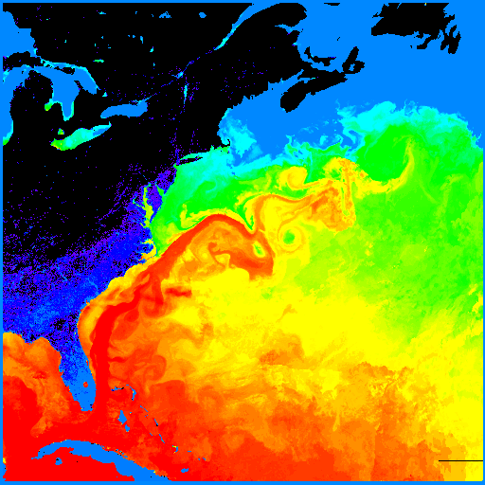
AVHRR
Sea Surface
Temperature
(thermal infrared)

Slide 3
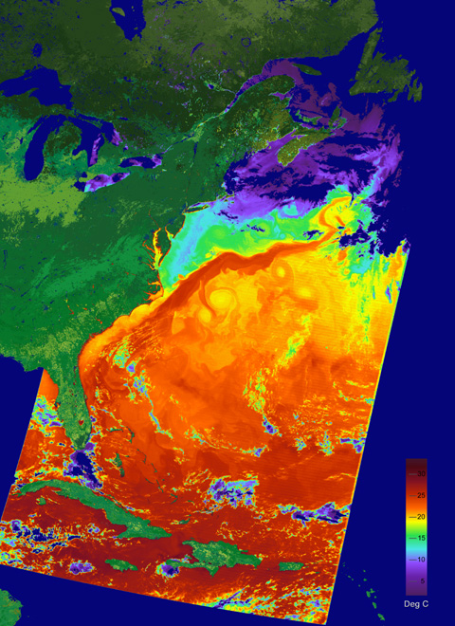
MODIS
Sea Surface
Temperature
(thermal infrared)

Slide 4
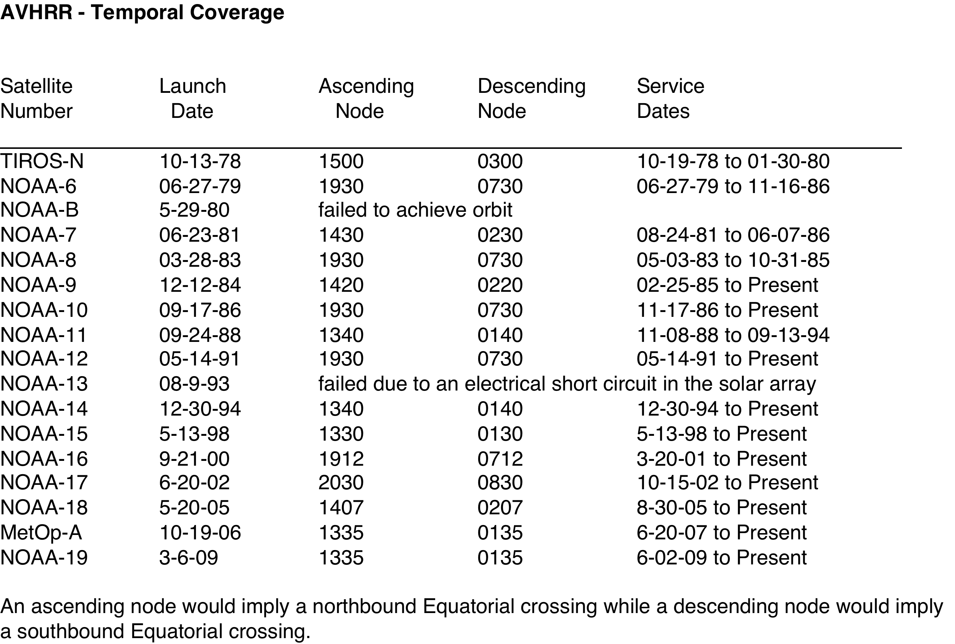

Slide 5
Spatial Resolution and Data Formats
The average instantaneous field-of-view (IFOV) = 1.4 mrad
Orbit altitude = 833 km (517 mi).
Ground resolution = 1.1 km at the satellite nadir
Orbit time = 102 minutes
HRPT data
• Full resolution image data transmitted to a ground station as they are collected.
LAC data
• Full resolution data recorded on an on board tape for subsequent transmission during a station overpass.
• 11+ minutes of LAC can be accommodated on a single recorder
GAC data
• Derived from a sample averaging of the full resolution AVHRR data.
• Four out of every five samples along the scan line are used to compute one average value and the data from only every third scan line are processed, yielding 1.1 km by 4 km resolution at the sub-point.
• 115 minutes of GAC imagery can be stored on a recorder, enough to cover an entire 102 minute orbit of data.

Slide 6
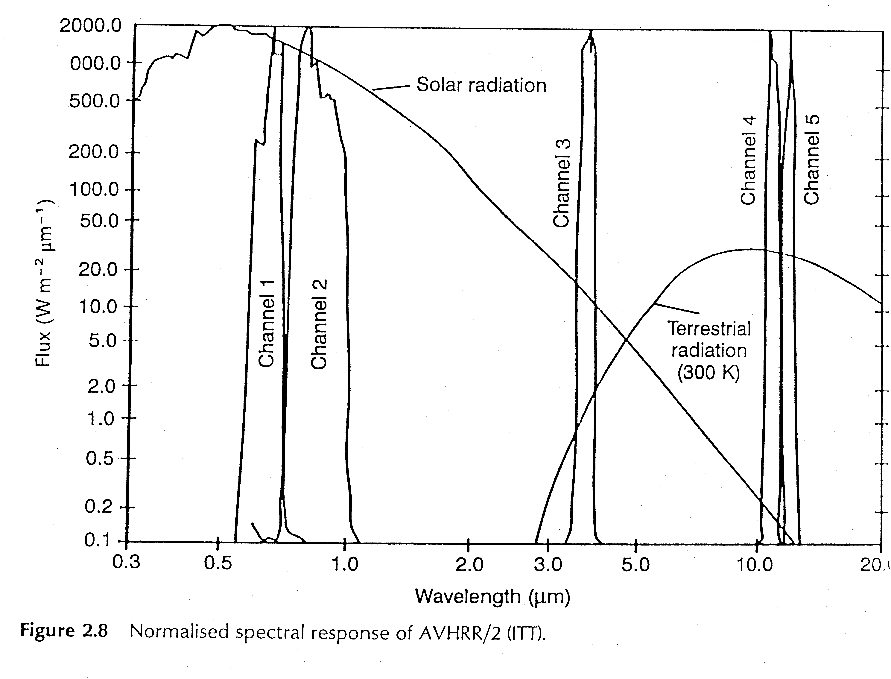

Slide 7
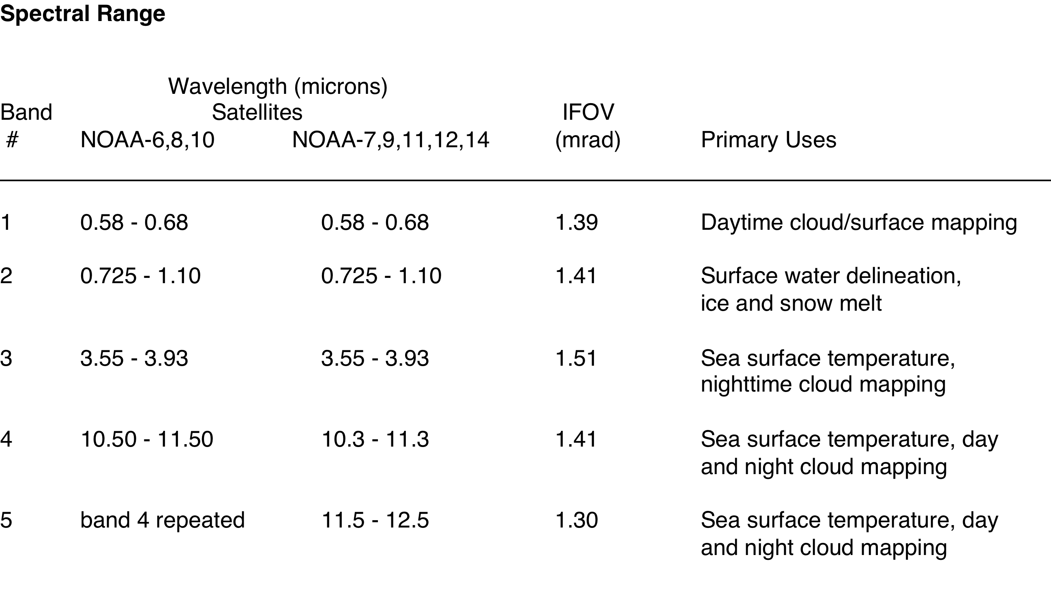

Slide 8
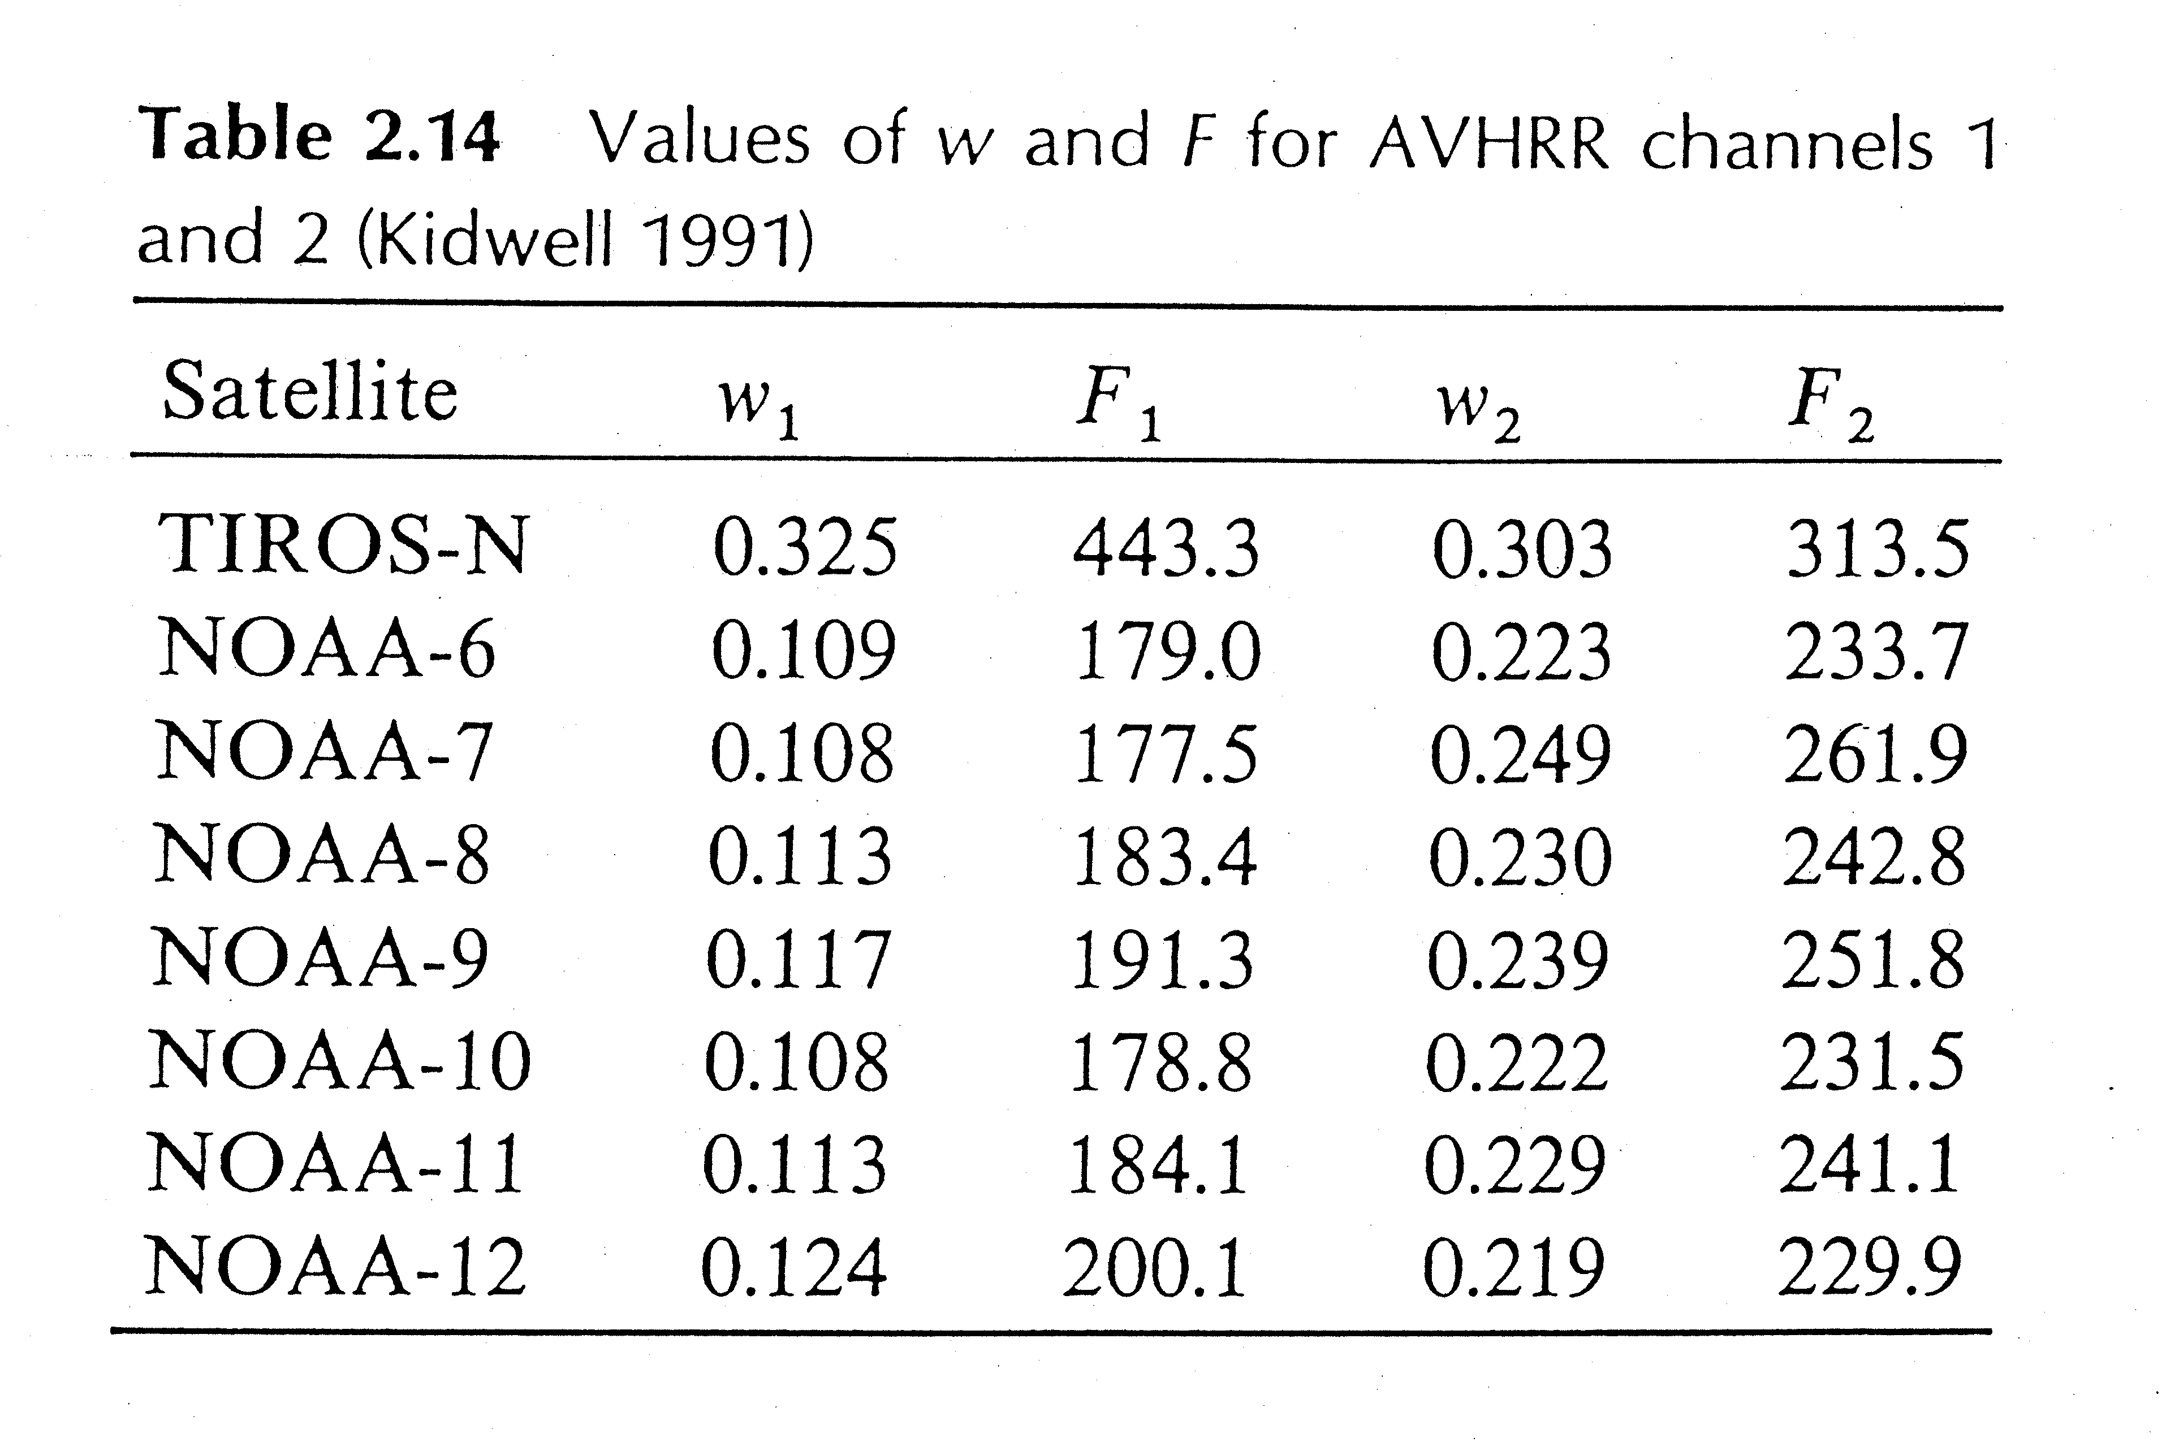

Slide 9
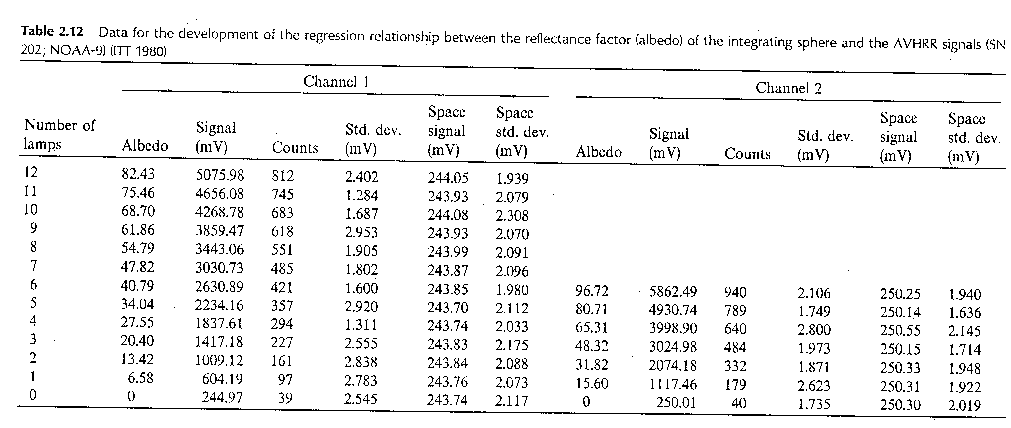

Slide 10
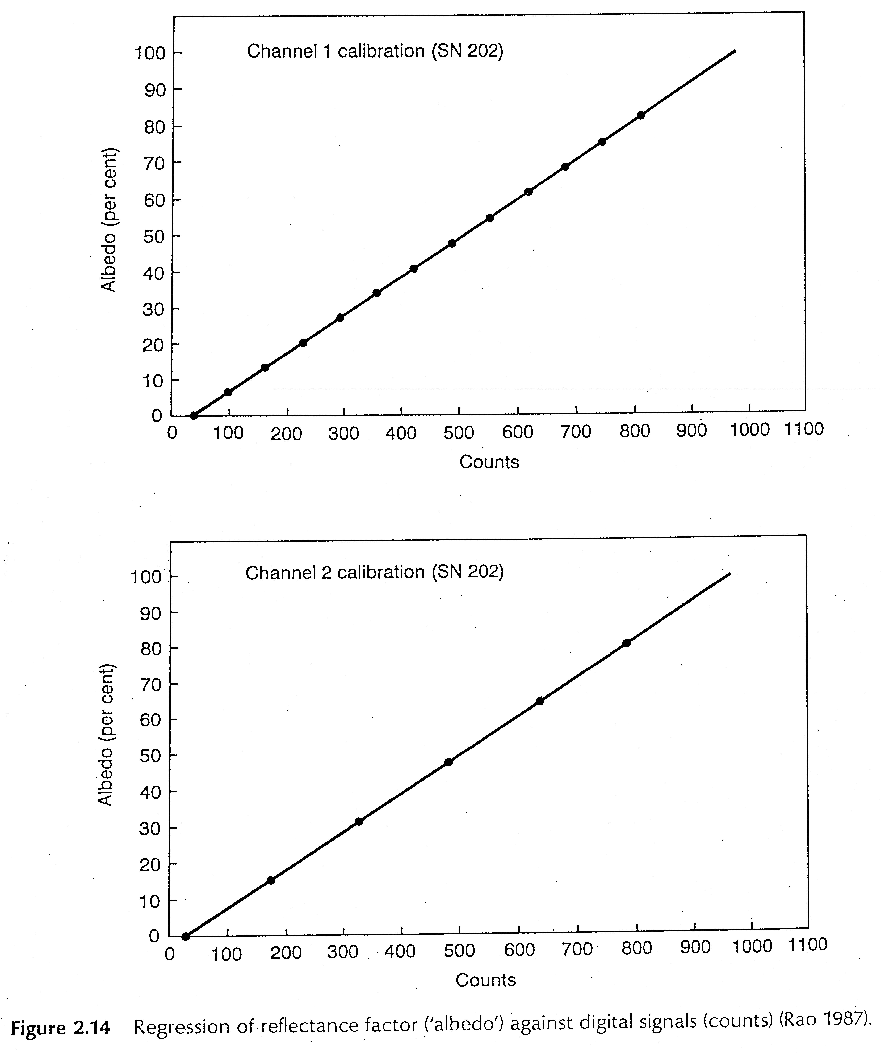

Slide 11
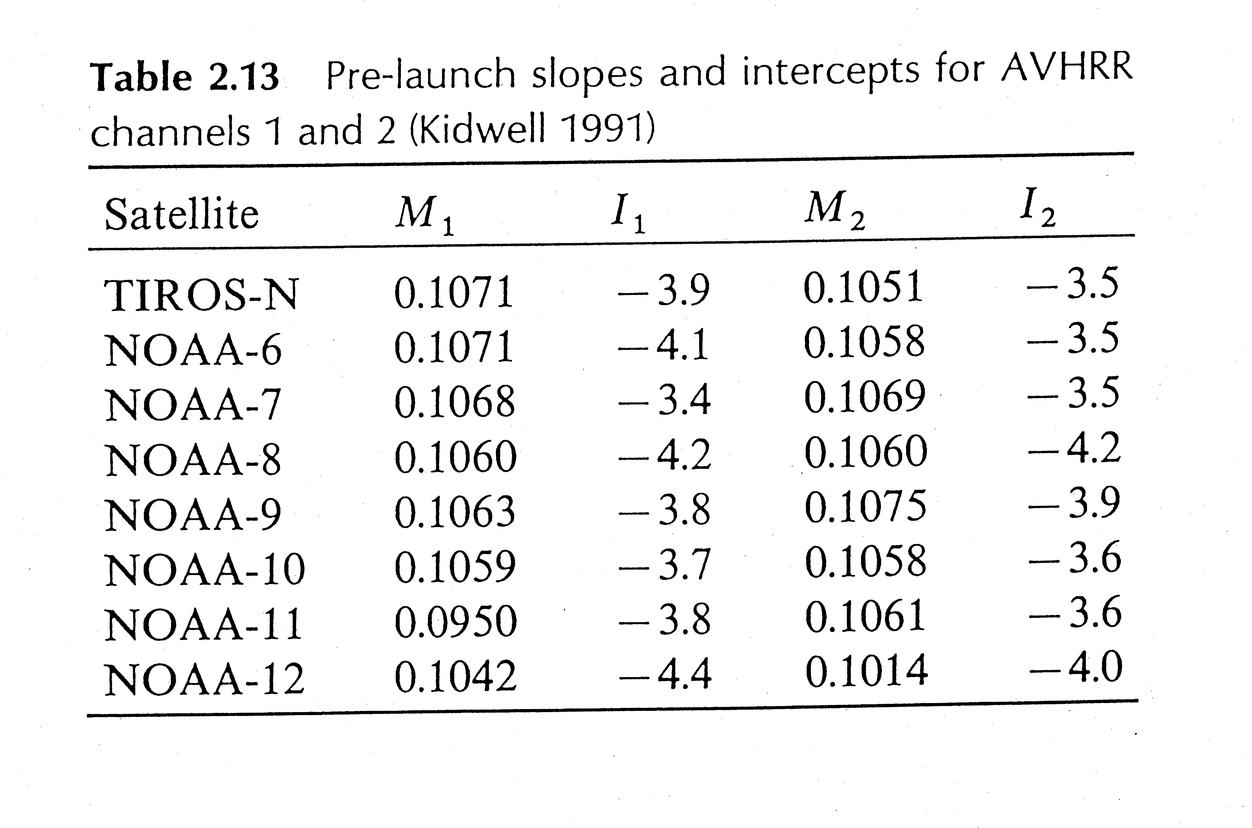

Slide 12
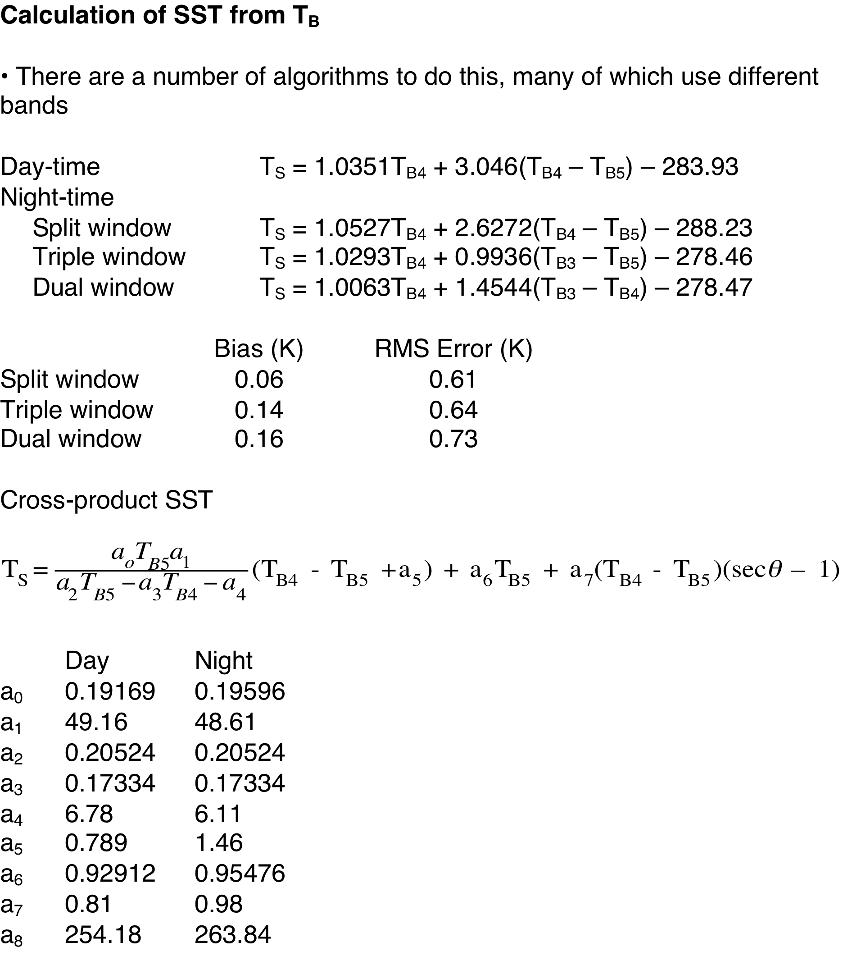

Slide 13
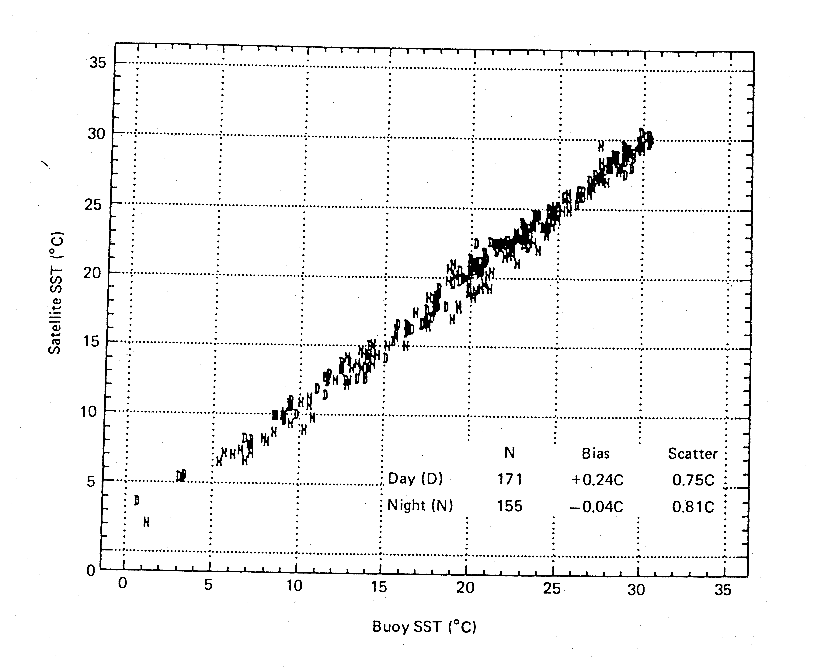

Slide 14
