Slide 1
Radiation

Slide 2
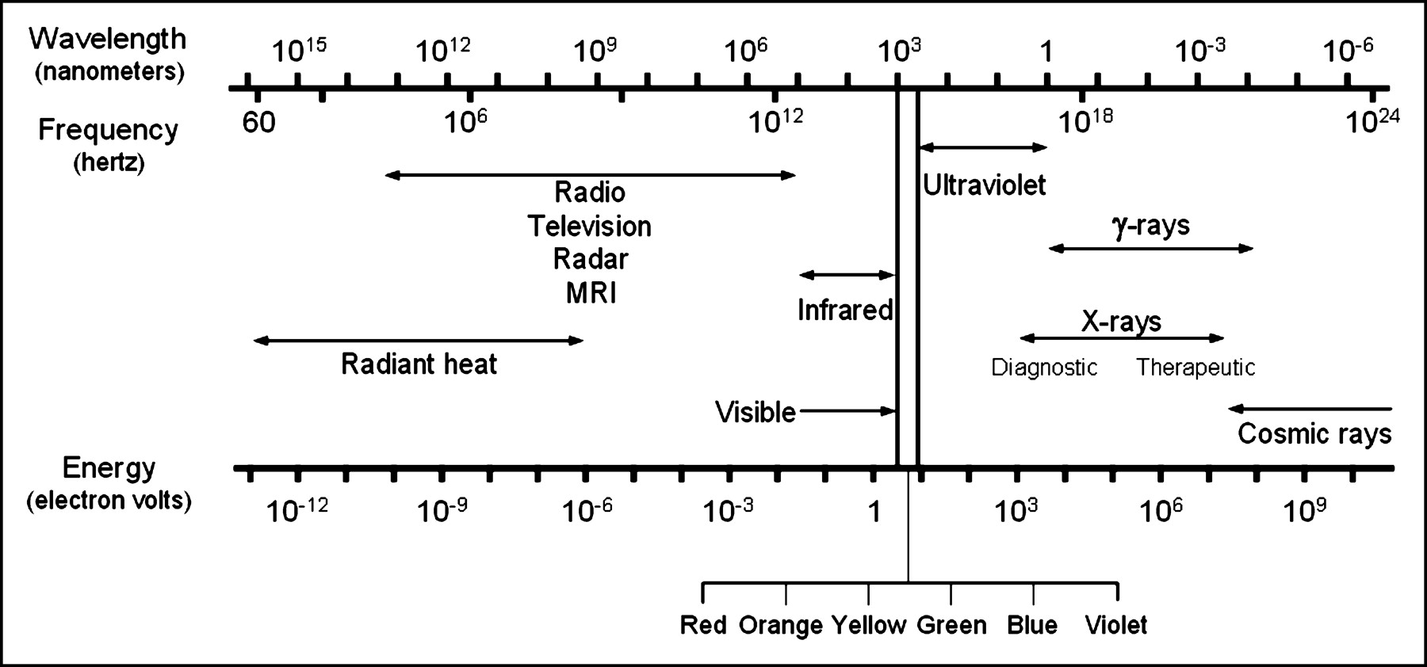

Slide 3
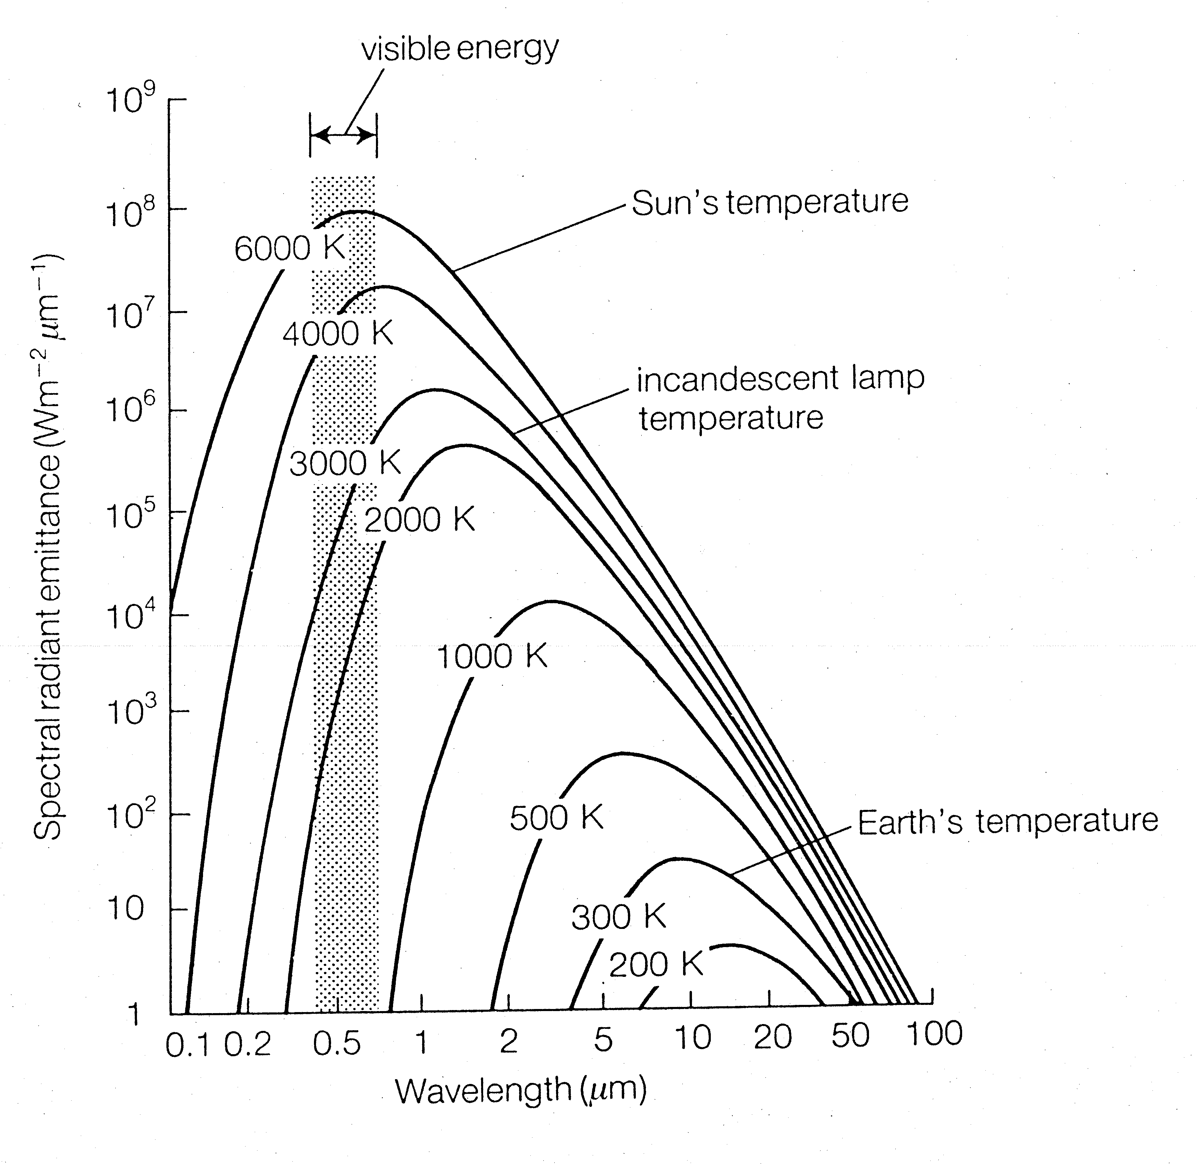

Slide 4
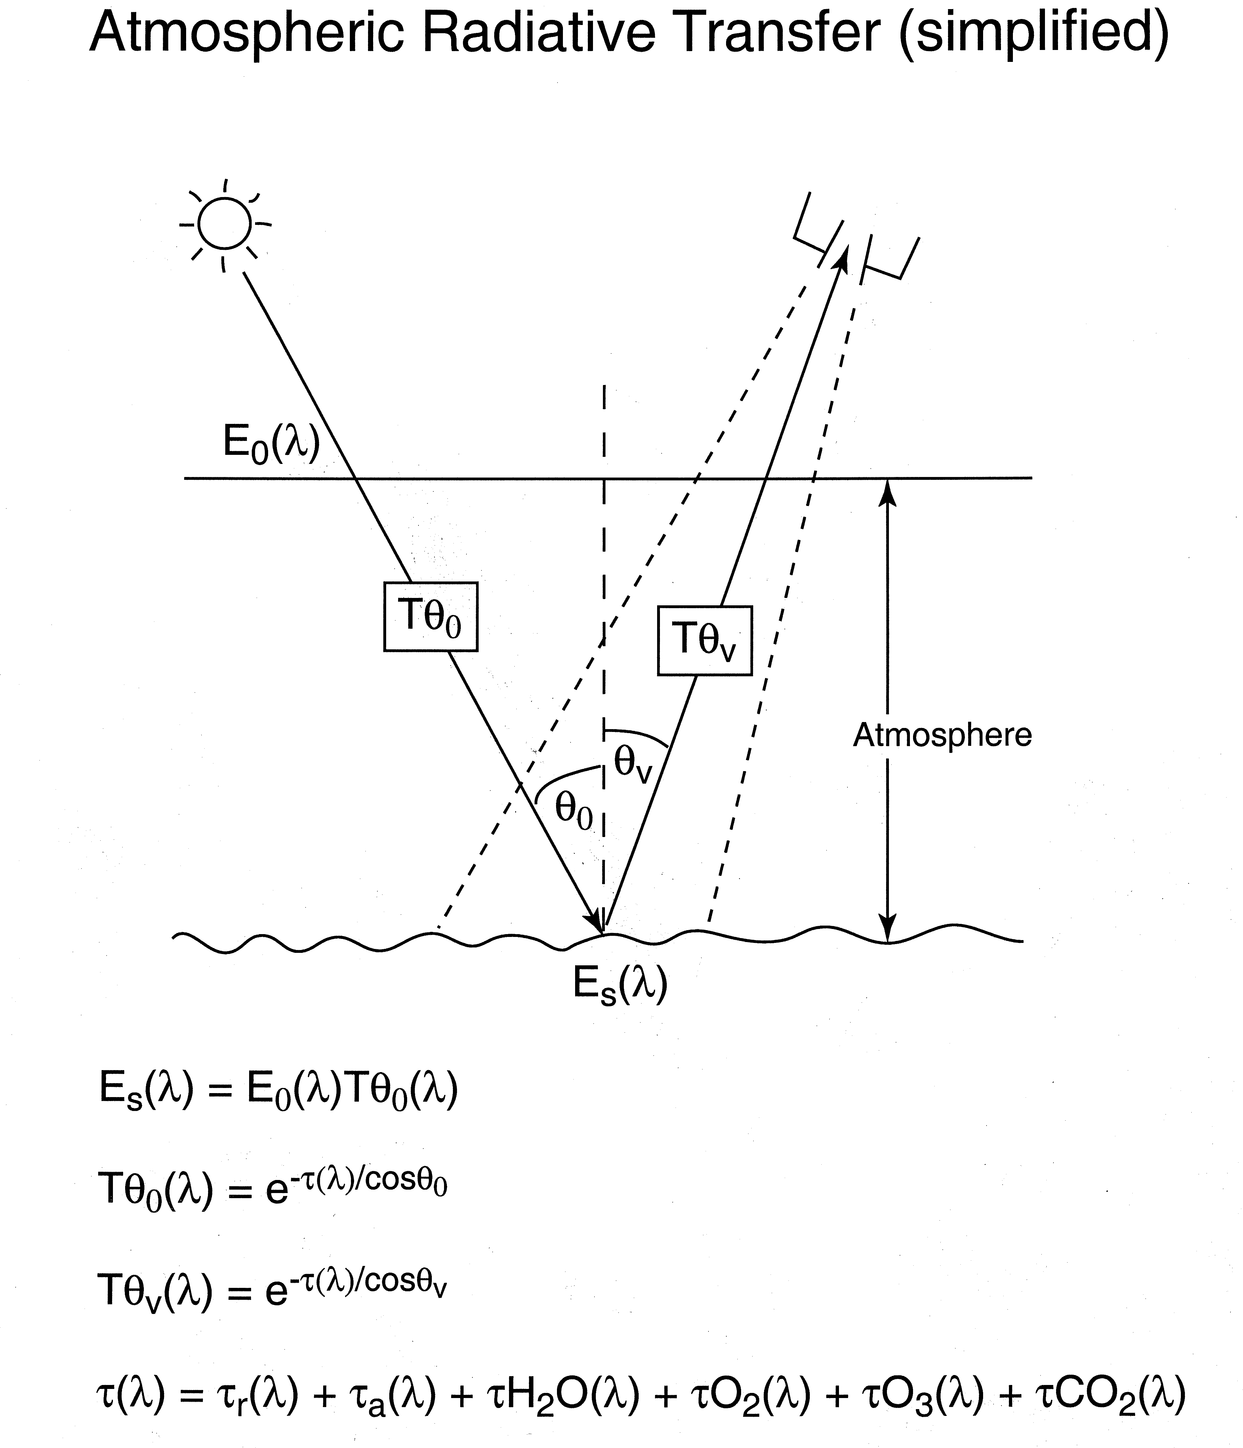

Slide 5
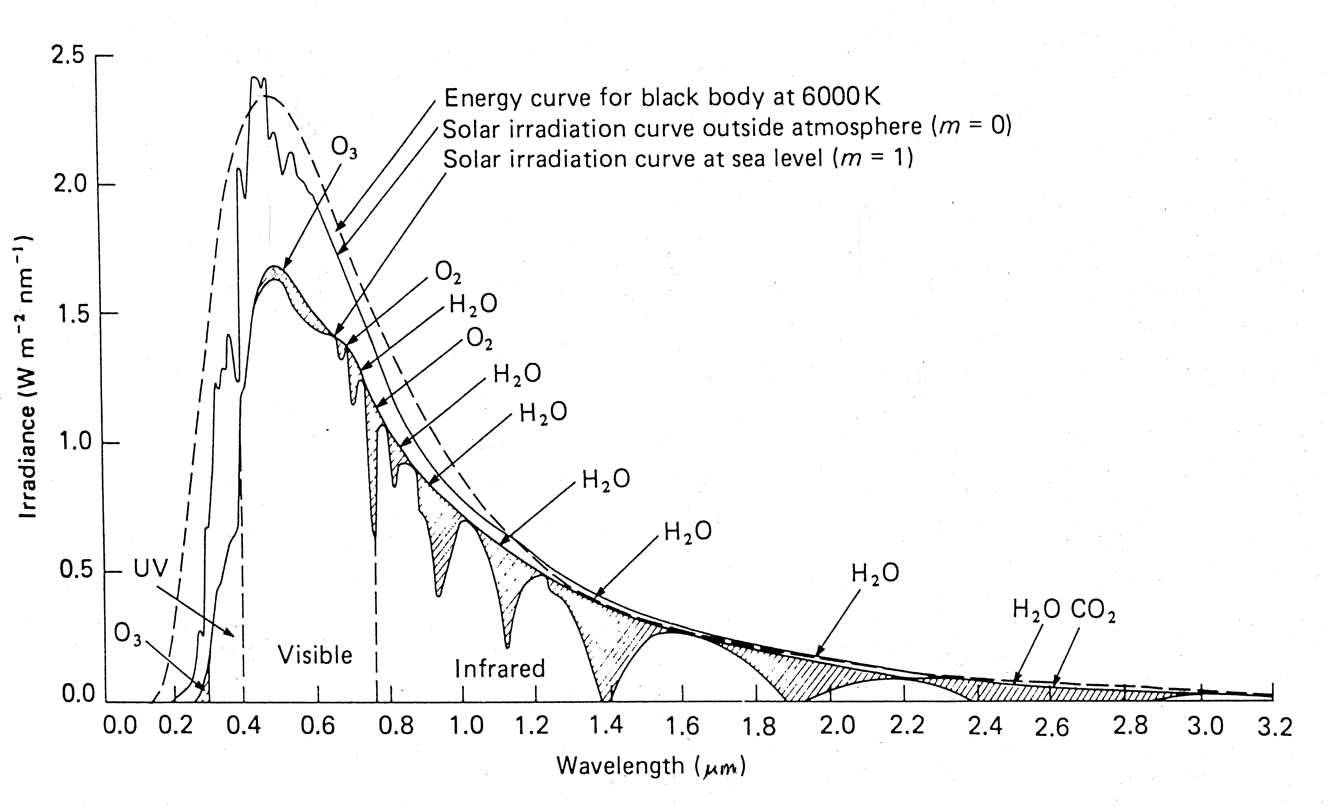
Scattering
Absorption

Slide 6
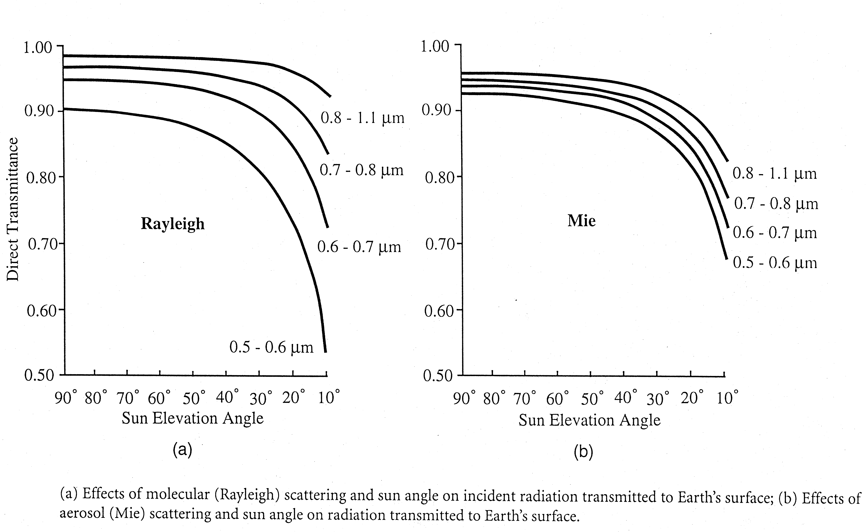
Atmospheric scattering
(Red-Infrared)
(Red-Infrared)
(Aerosol)
(Blue-Green)
(Blue-Green)

Slide 7
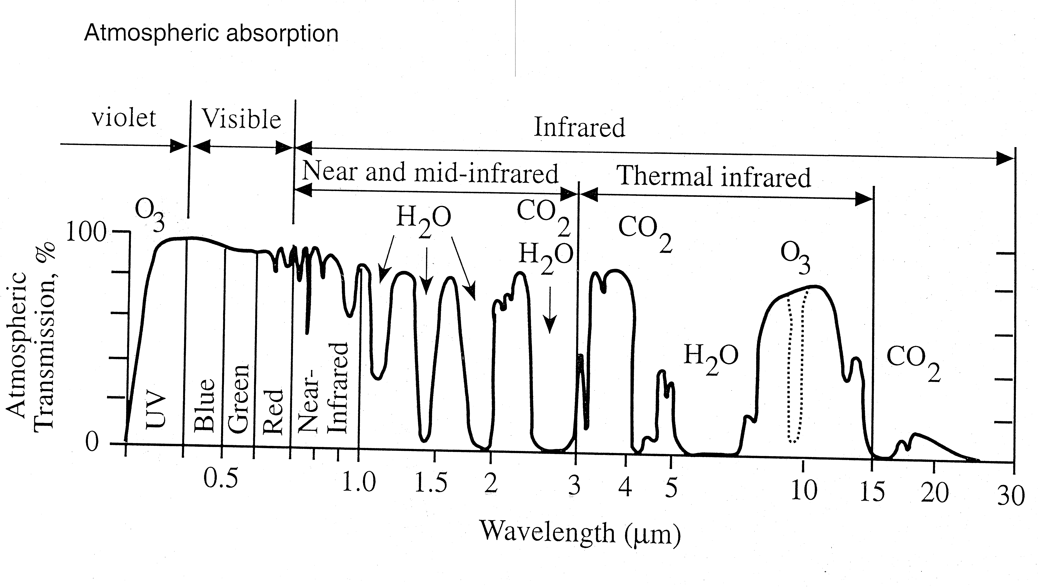
Atmospheric absorption
τ is small
τ is big
Atmospheric transmission = exp(-τ/cosθ₀)
Assumes light is coming straight down (θ₀=0) so cosθ₀ = 1

Slide 8
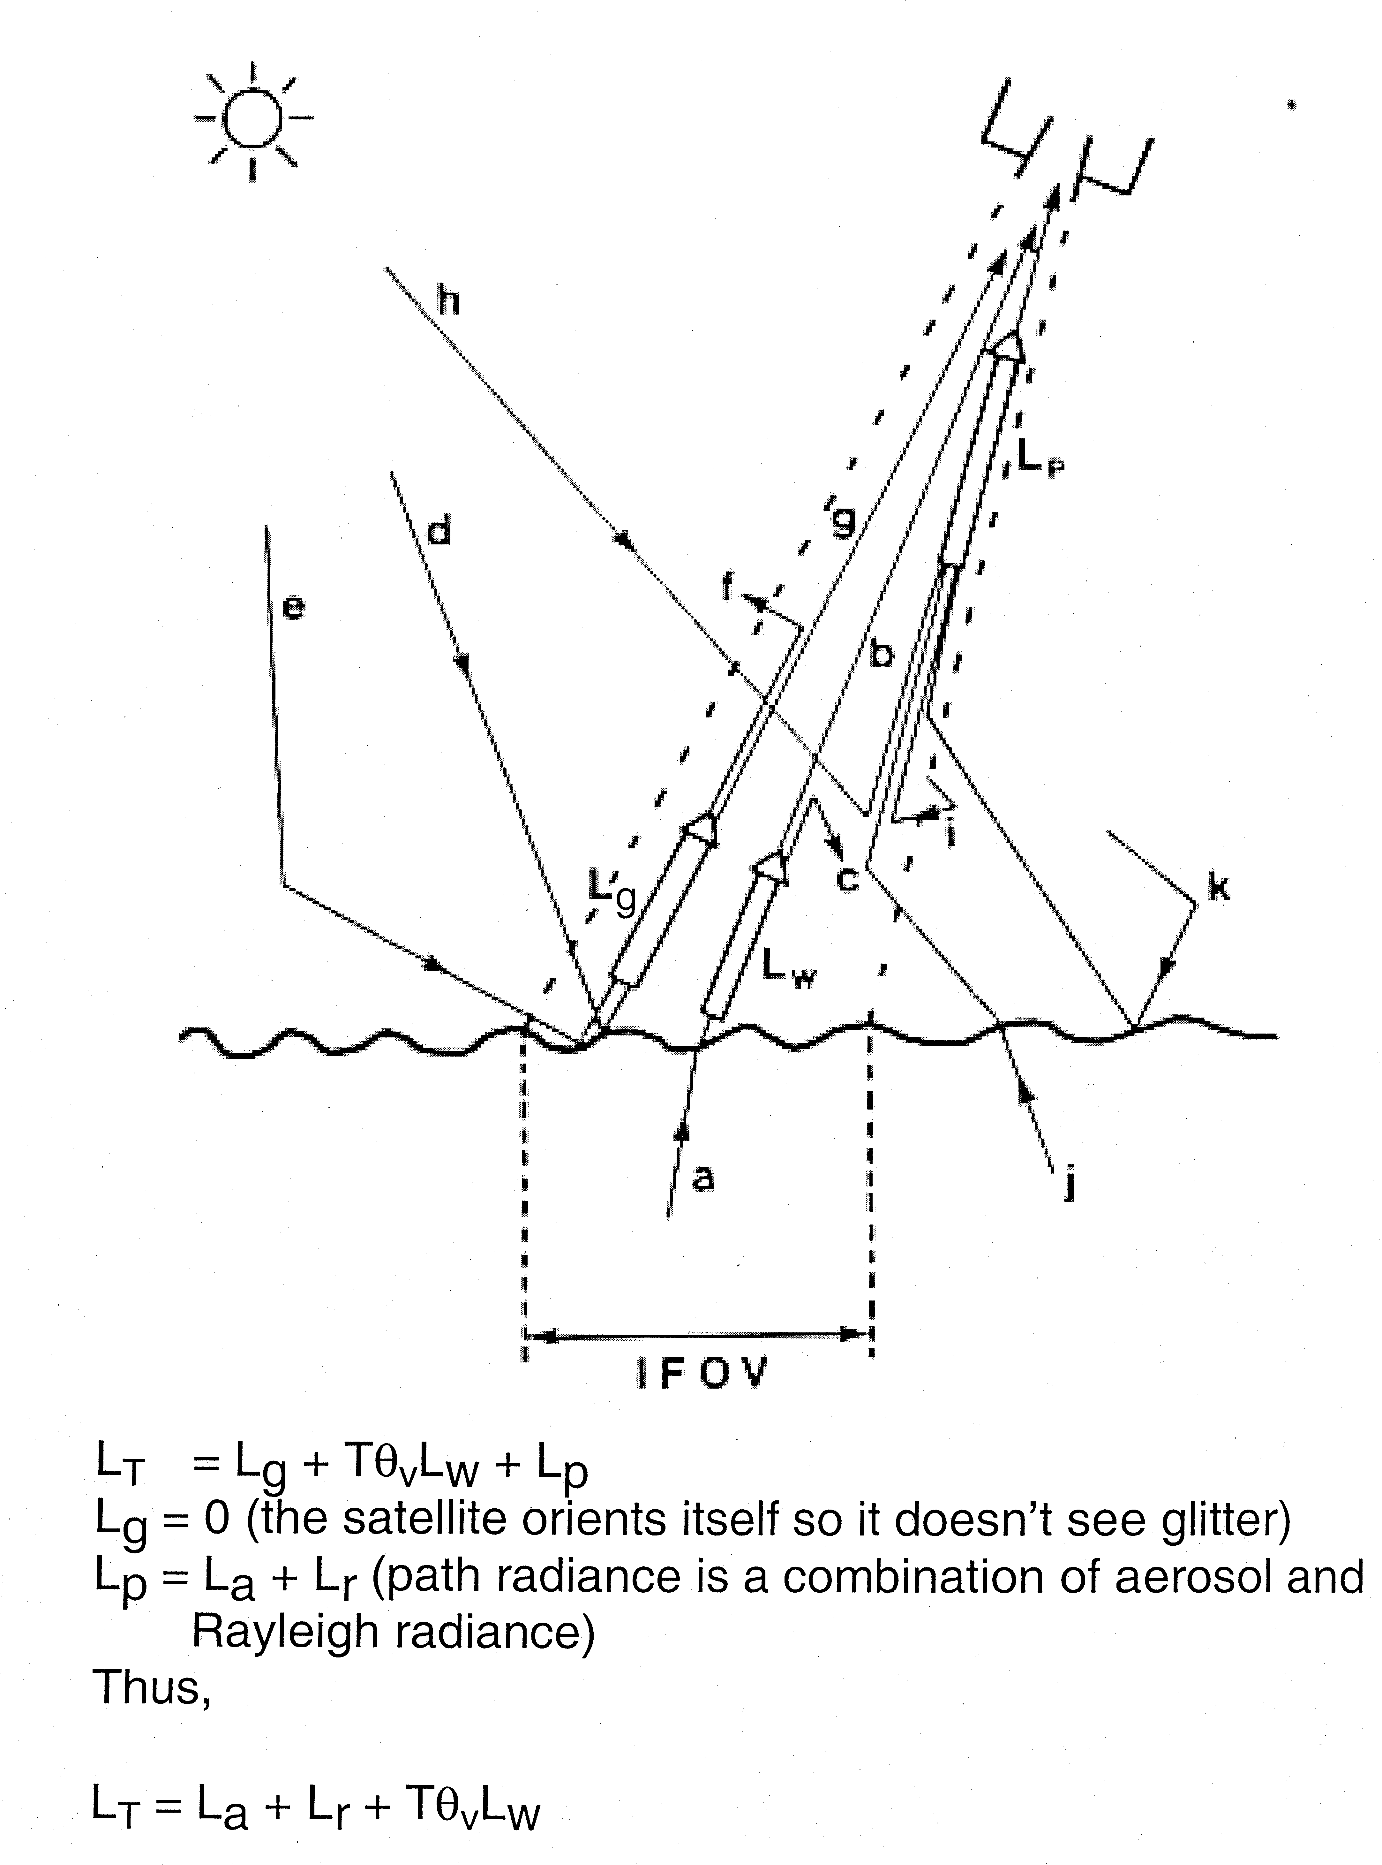
Need to account for
Tθ_{v}(λ) = exp(-τ(λ)/cosθ_{v})
(transmission from Earth to satellite)

Slide 9
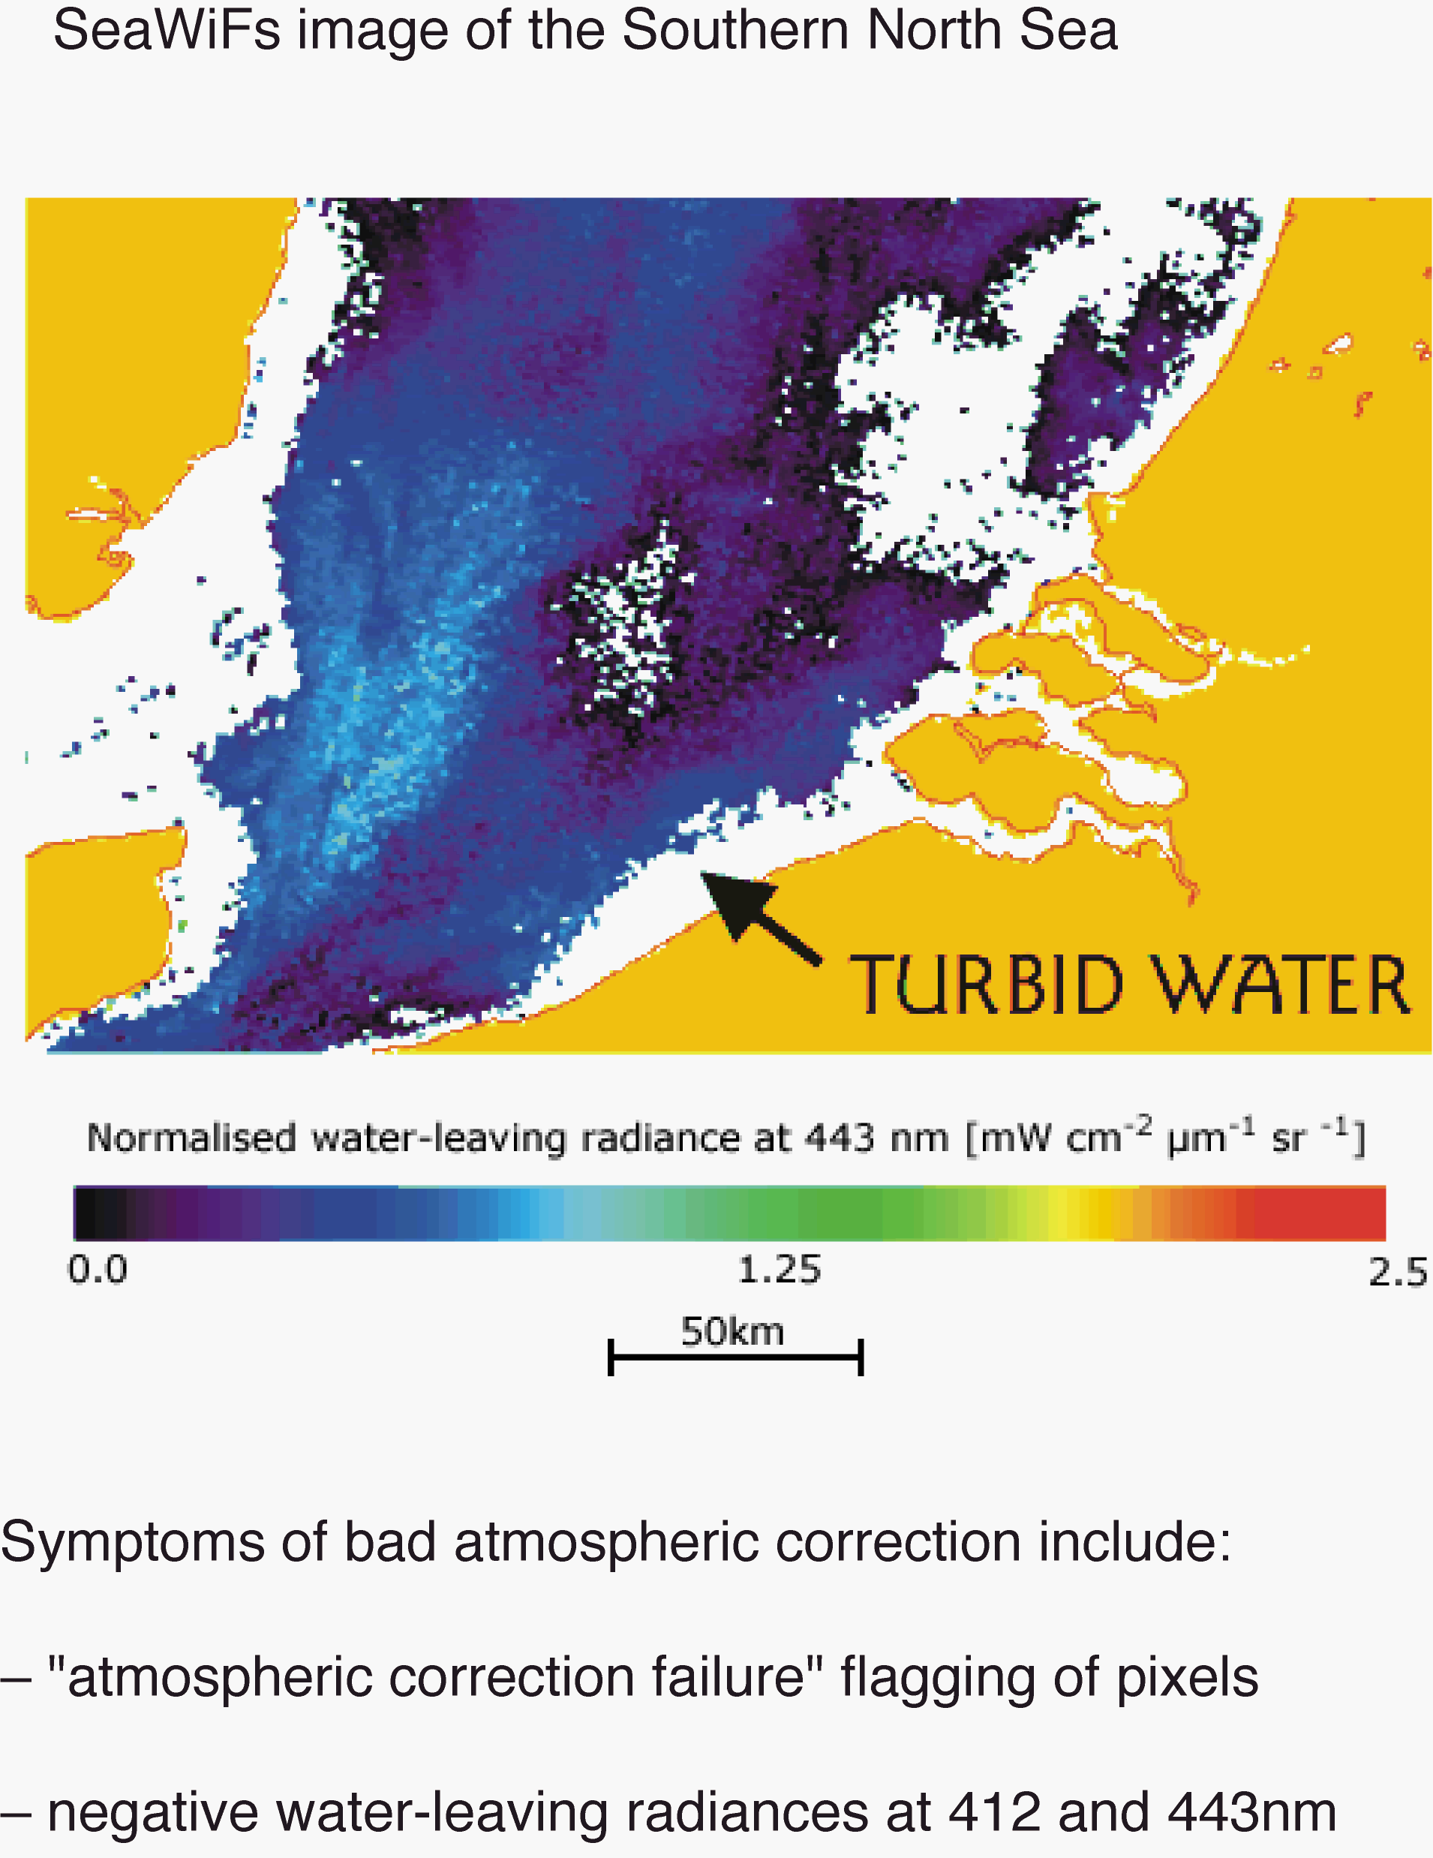

Slide 10
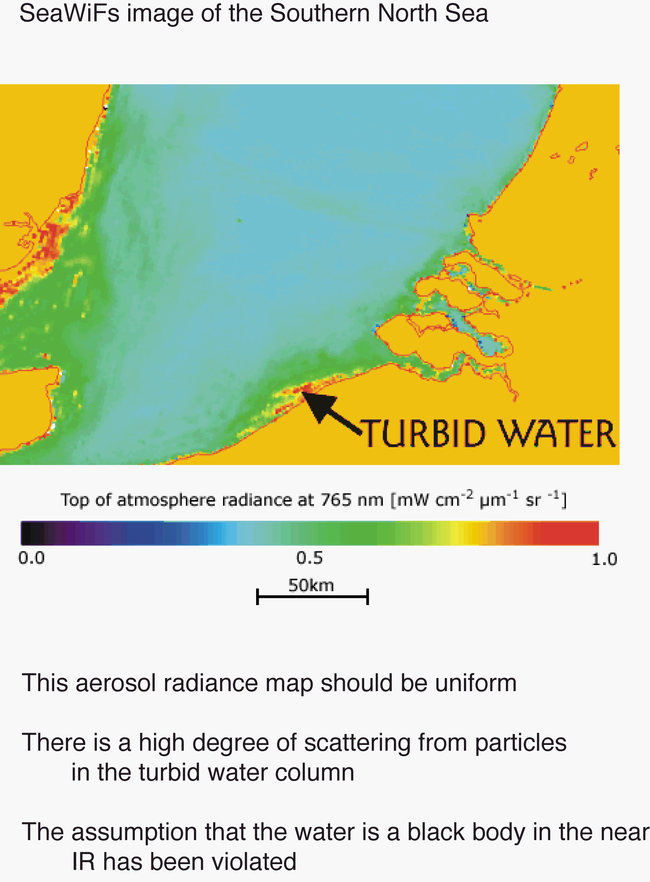

Slide 11
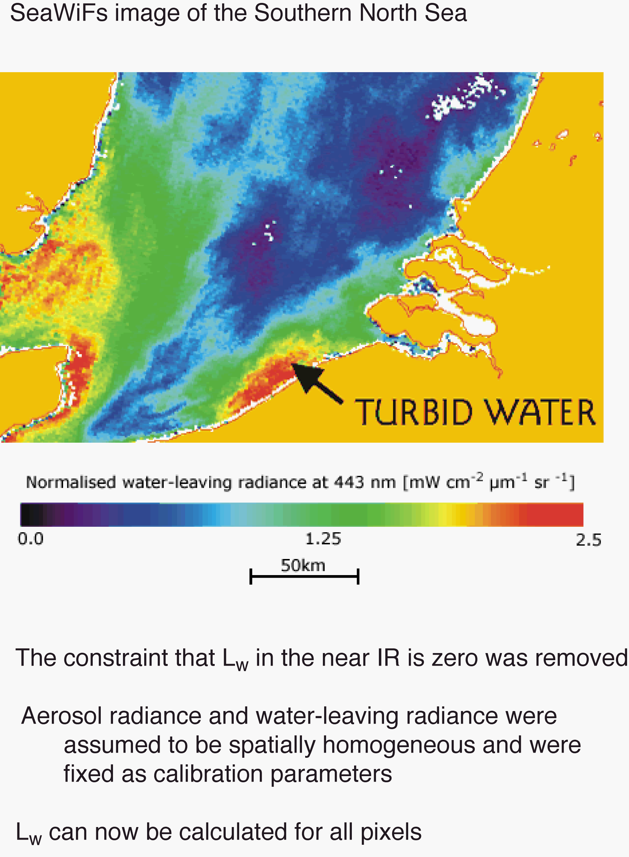

Slide 12
