Slide 1
RADAR Altimetry & Scatterometry

Slide 2
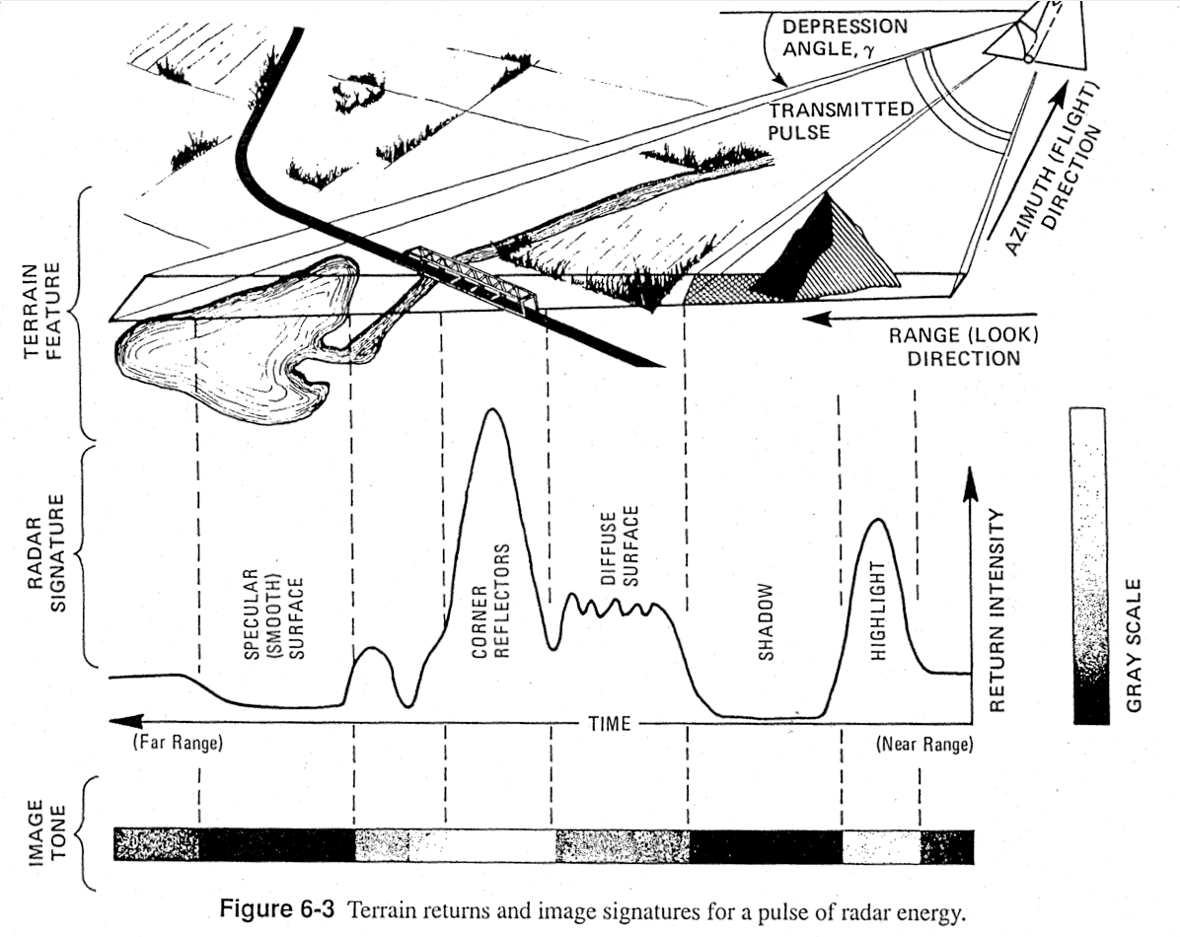

Slide 4
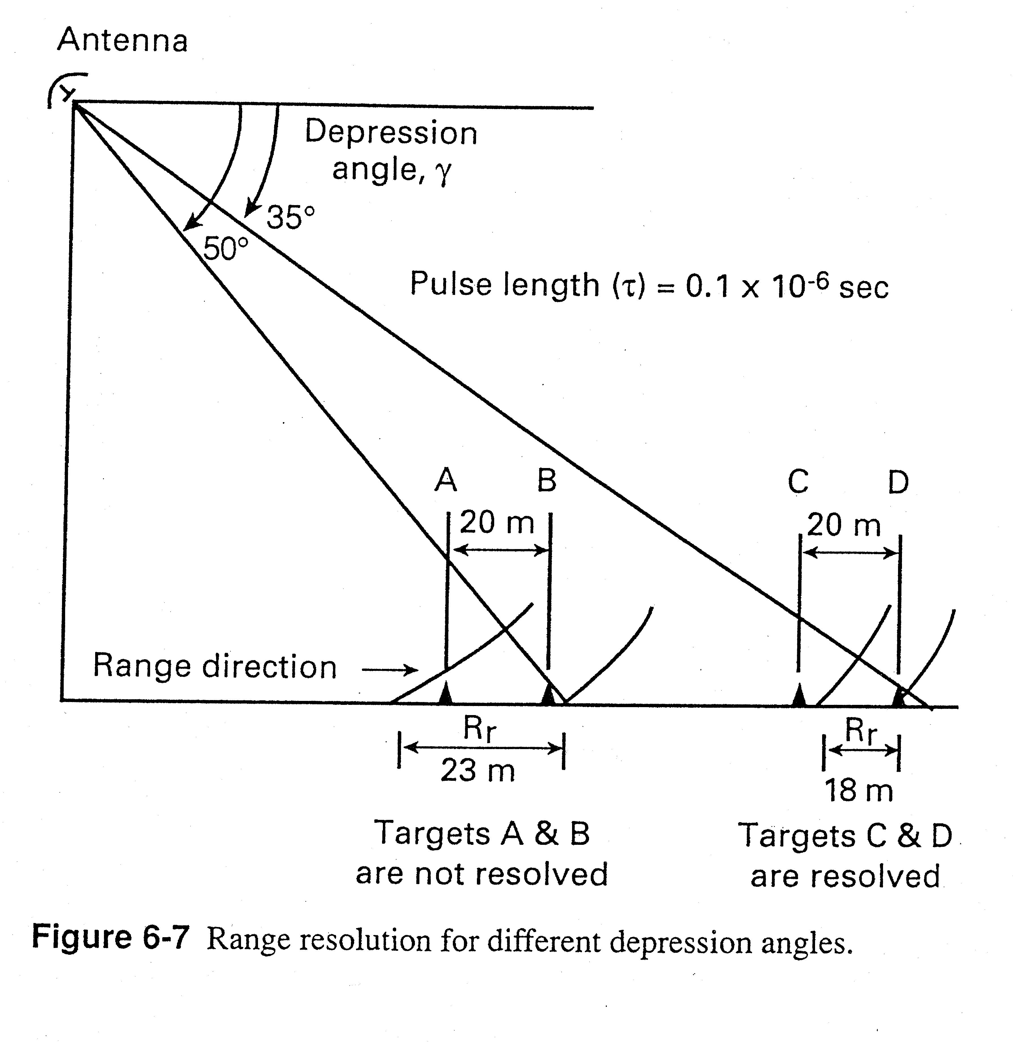

Slide 5
Range resolution – examples
Rr = τ c/2cos(γ)

Slide 6
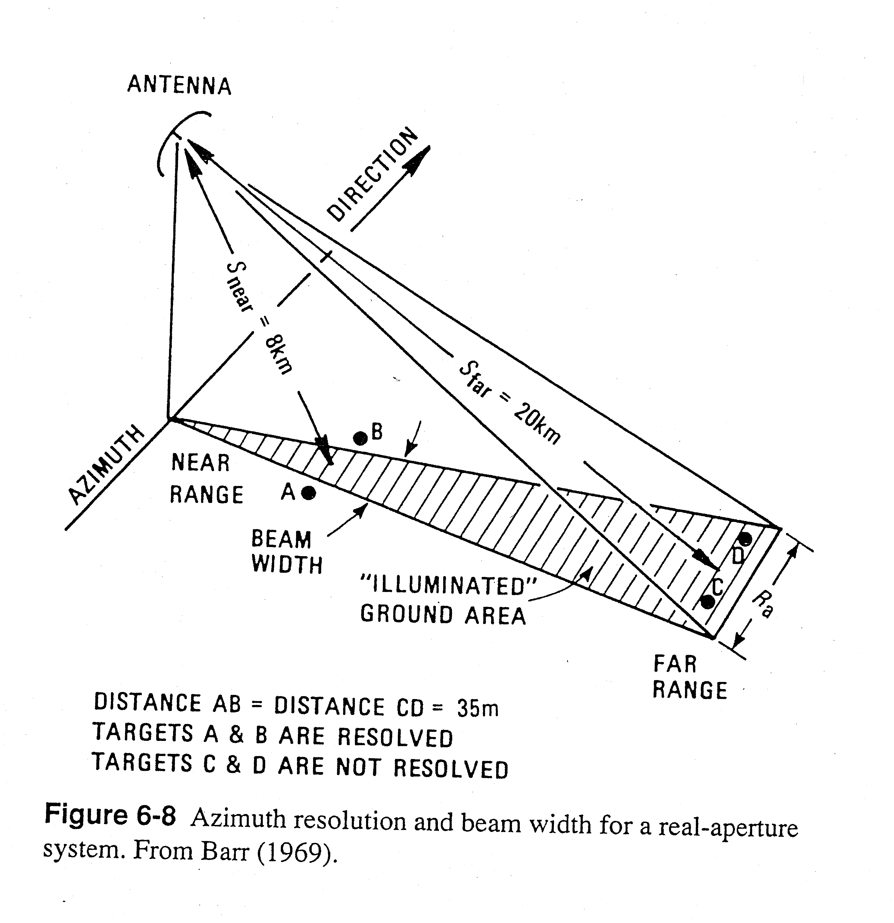
Azimuth resolution

Slide 7
Azimuth resolution – examples
Ra = (0.7)(S)(λ)/D

Slide 8
Altimetry

Slide 9
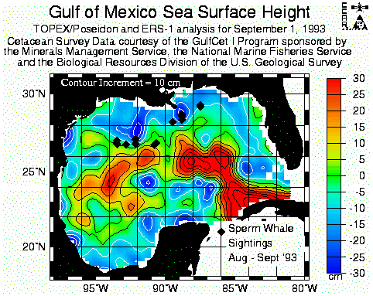

Slide 10
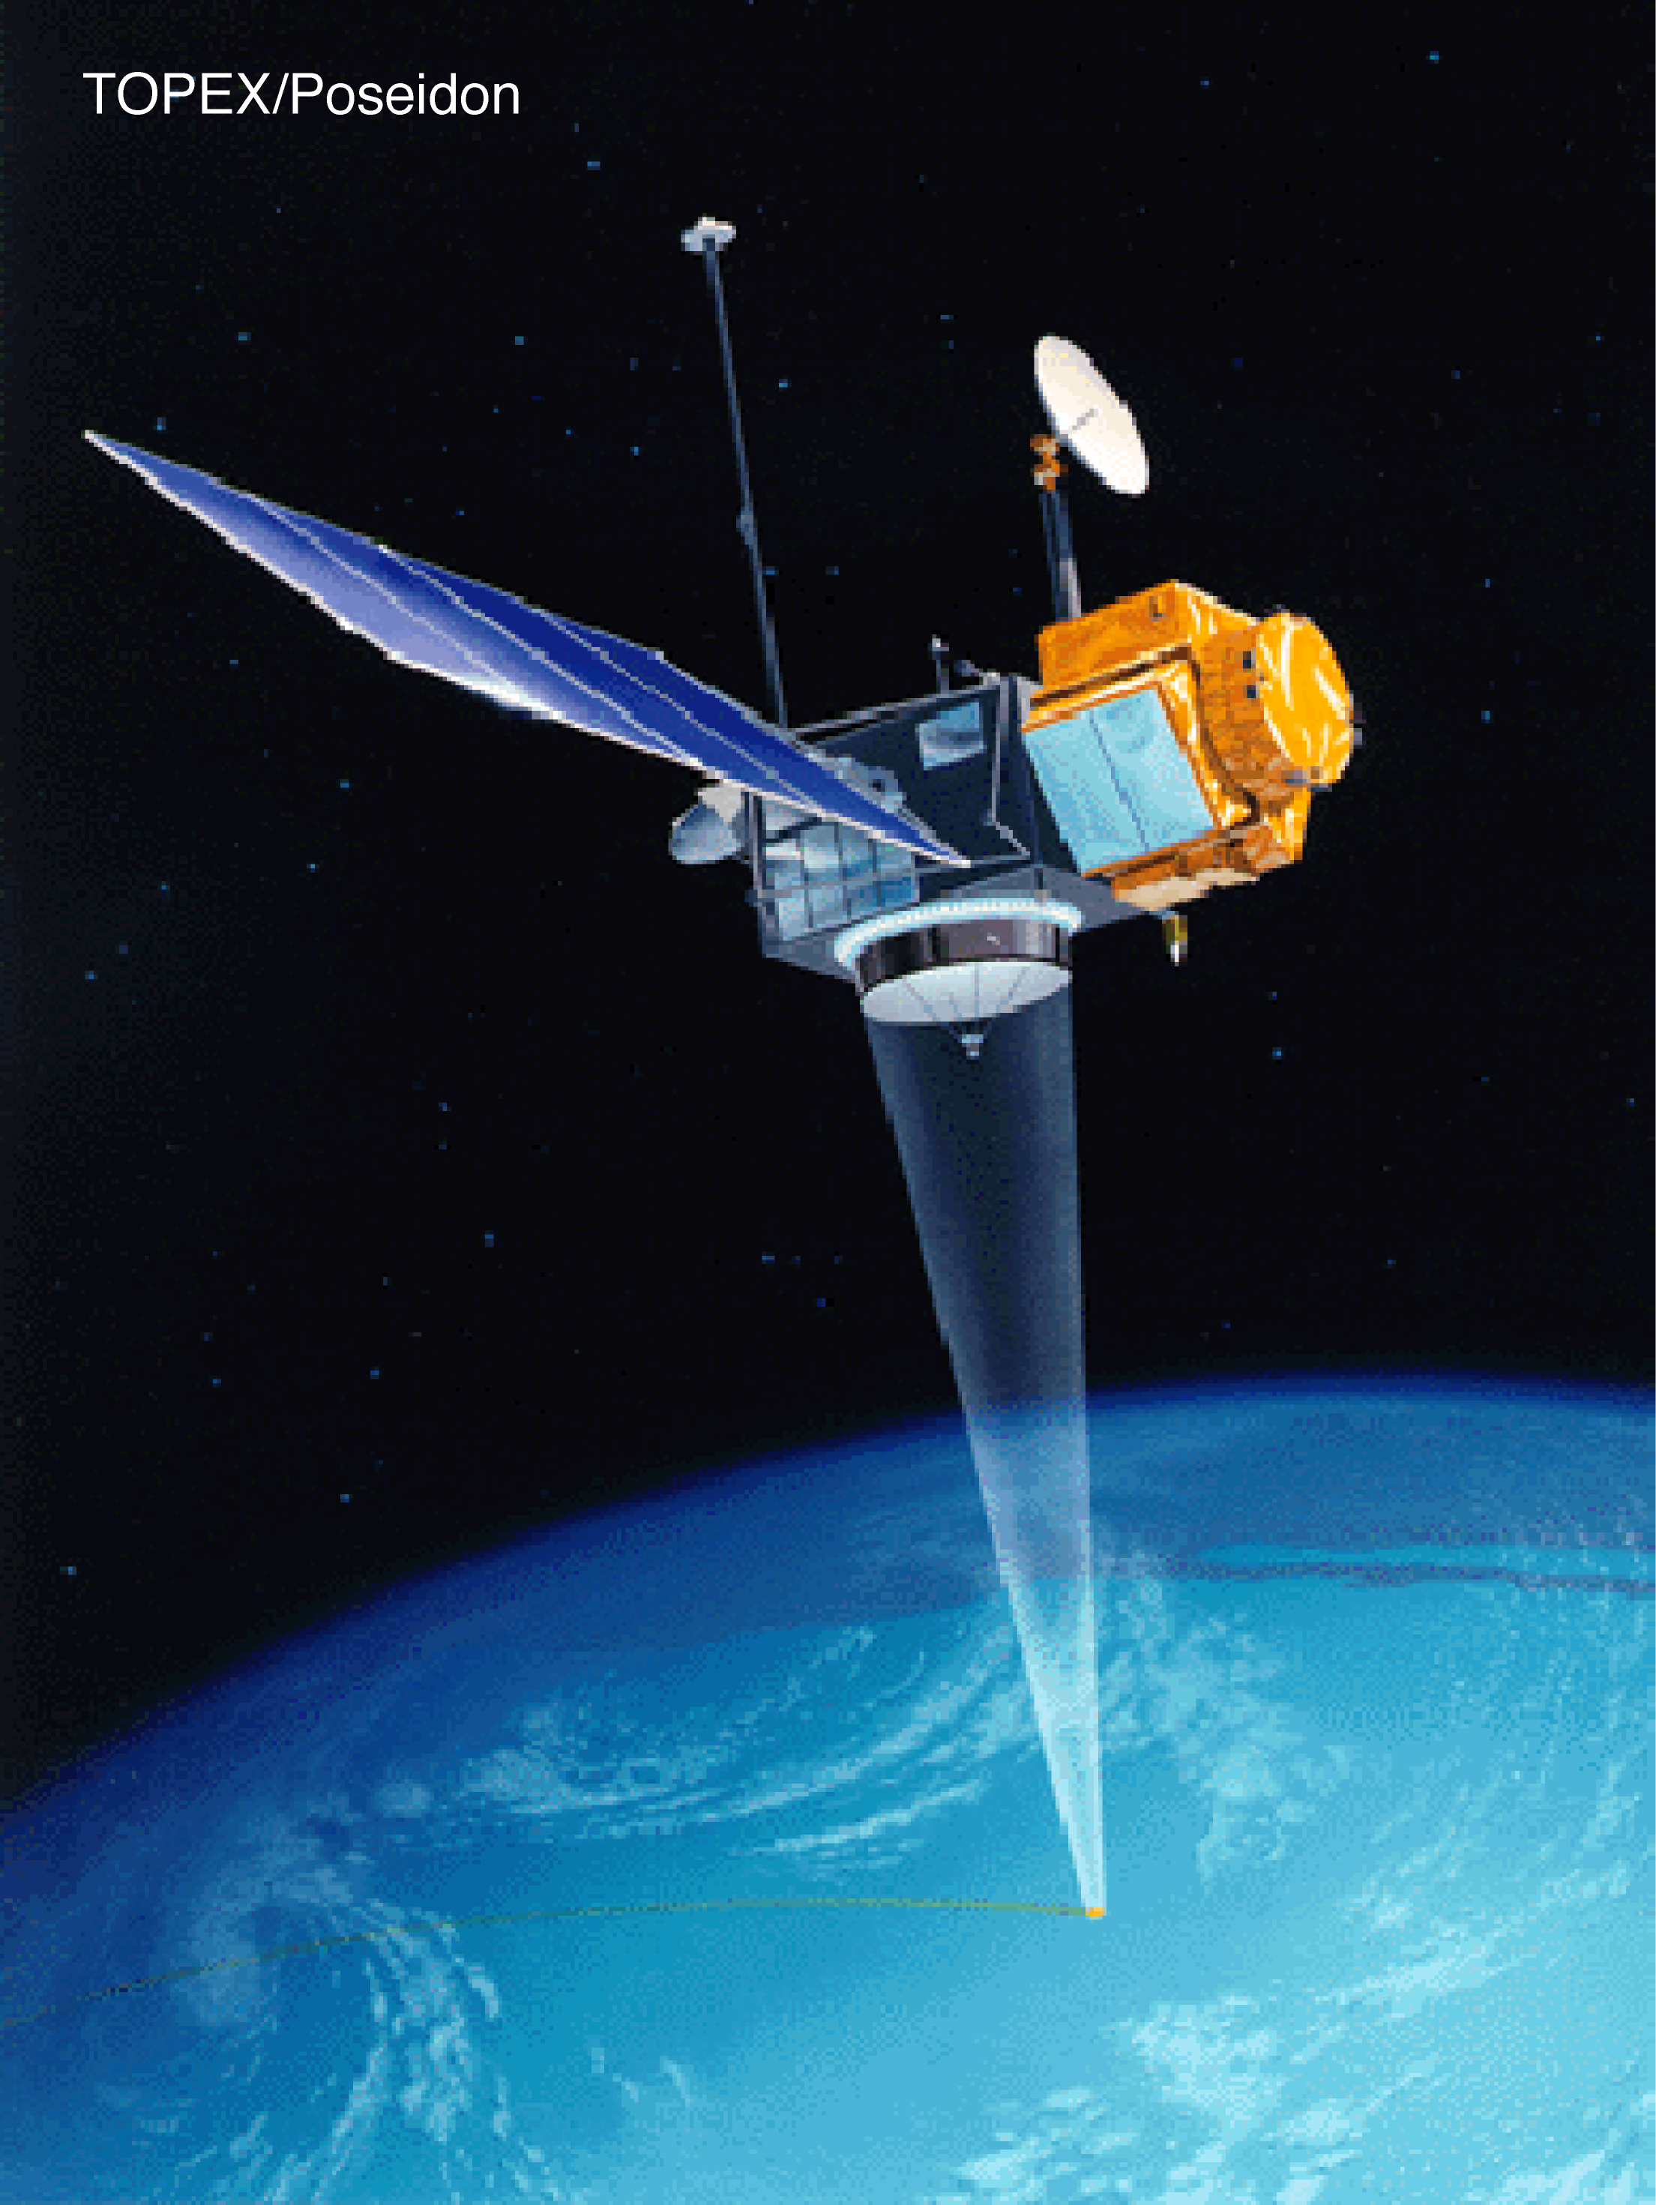
Lifetime 1992-2006
Altitude 1335 km
Pulse length 3.125 nsec
Repeat time 9.9156 days
Resolution 25 km
Frequency 13.65 GHz
Follow-on Missions
Jason-1 2001
Jason-2 2008
Jason-3 2013

Slide 11
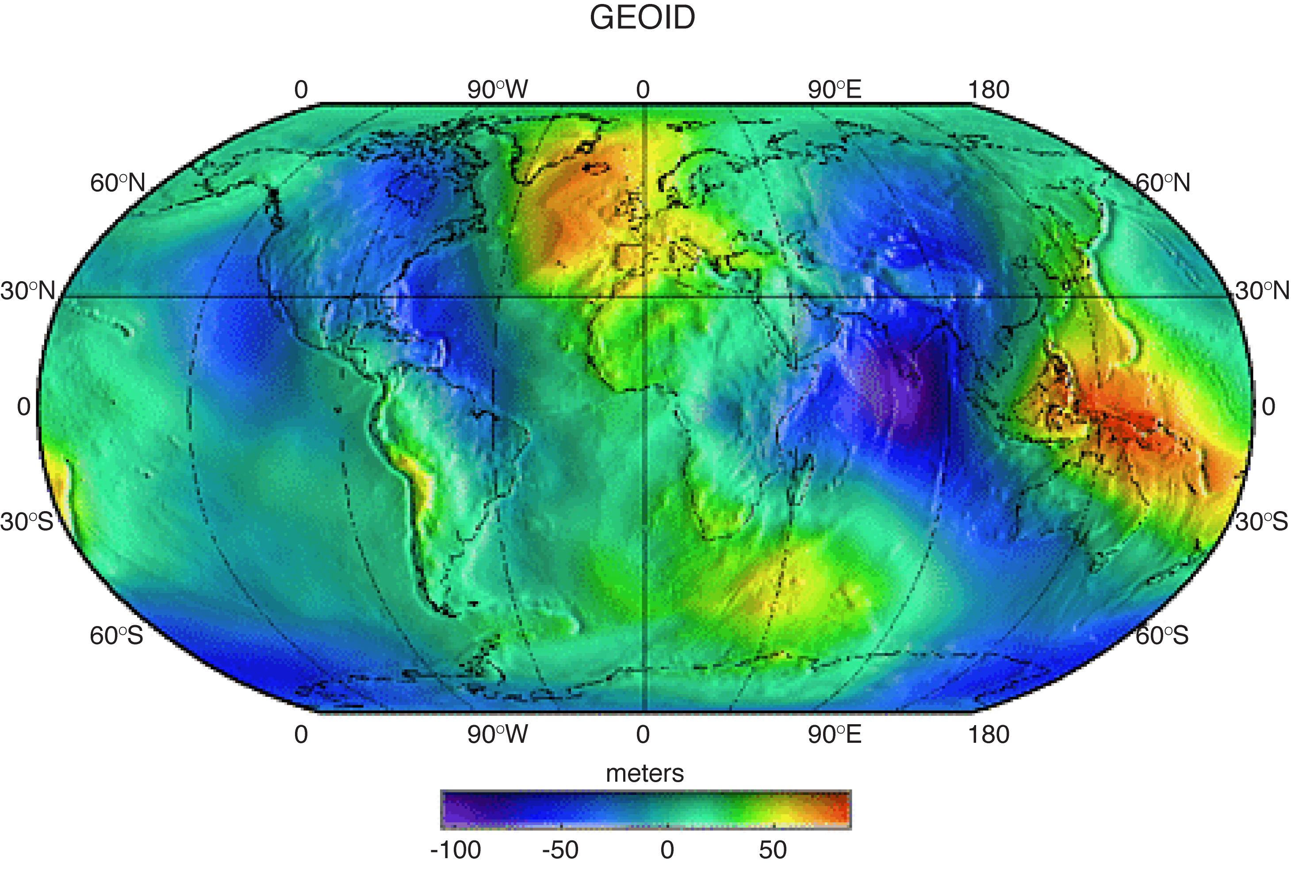

Slide 12
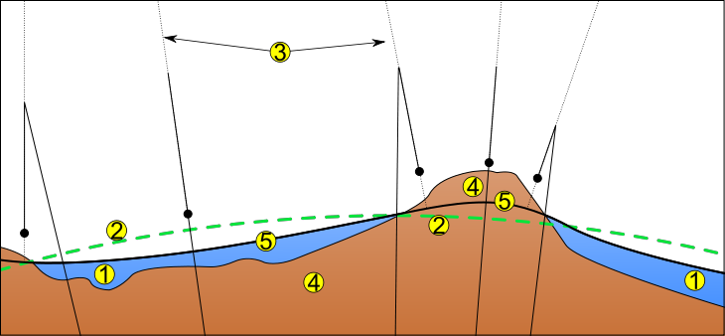
1 Ocean
2 Reference ellipsoid
3 Local plumb line
4 Continent
5 Geoid
- Geoid height given relative to reference ellipsoid
- Reference ellipsoid is best fit to geoid
- Sea surface height measured relative to geoid (<100 m)
Using a sphere would result in height differences between geoid as large as 20 km due to equatorial bulge

Slide 13
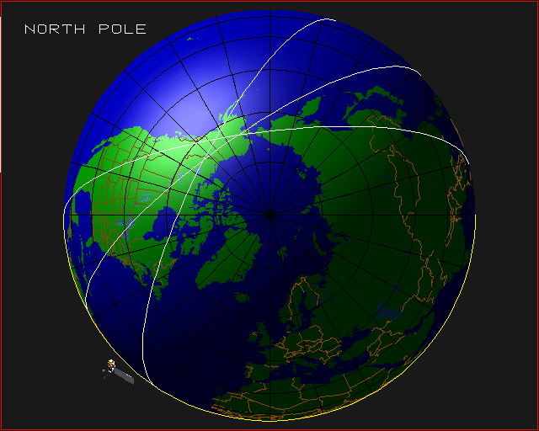
Instead of the GEOID, measurements can be made relative to repeated orbits

Slide 14
Scatterometry

Slide 15
Scatterometers and their characteristics
Scatterometer Period Spatial Scan Operational
in Service Resolution Characteristics Frequency
SeaSat-A July 7, 1978– 50 km with two sided, Ku band
Oct 10, 1978 100 km spacing double swath (14.6 GHz)
ERS-1 July 1991 – 50 km one sided, C band
May 21, 1997 single swath (5.3 GHz)
ERS-2 May 21, 1997– 50 km one sided, C band
Current single swath (5.3 GHz)
NSCAT Sep 15, 1996 – 25 km, and two sided, Ku band
Jun 30,1997 50 km double swath (13.995 GHz)
SeaWinds on Jul 19, 1999 - 25 km conical scan, Ku band
QuikSCAT Nov 23, 2009 one wide swath (13.995 GHz)
SeaWinds on Apr 10, 2003 25 x 6 km conical scan Ku band
ADEOS II Oct 24, 2003 one wide swath (13.995 GHz)
ASCAT May 2007- 50 km conical scan C band
Current one wide swath (5.255 GHz)
RapidScat on Sep 20, 2014- 16 km conical scan Ku band
Int. Space Sta. Current 1000 km swath (13.4 GHz)

Slide 16
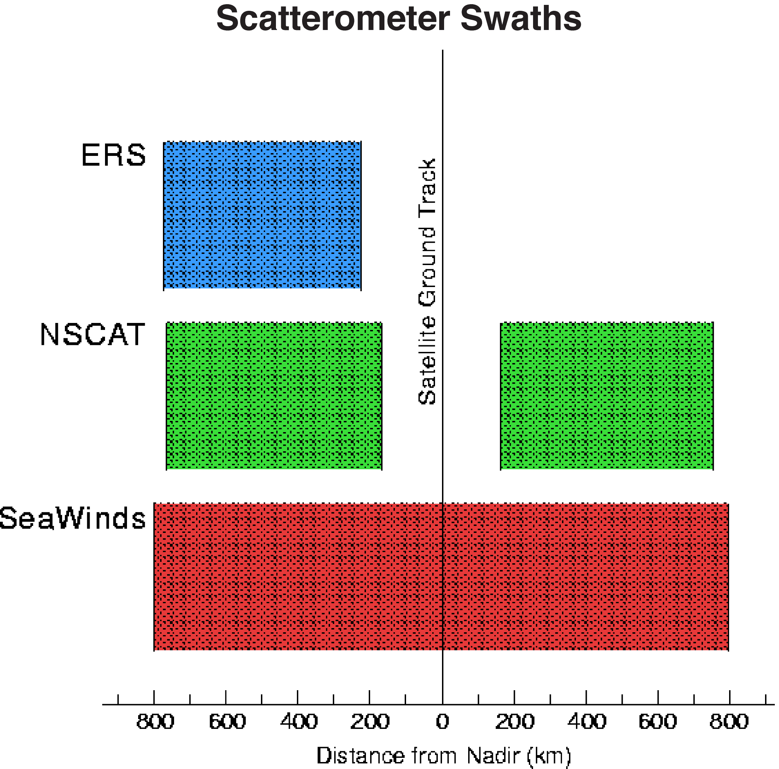

Slide 17
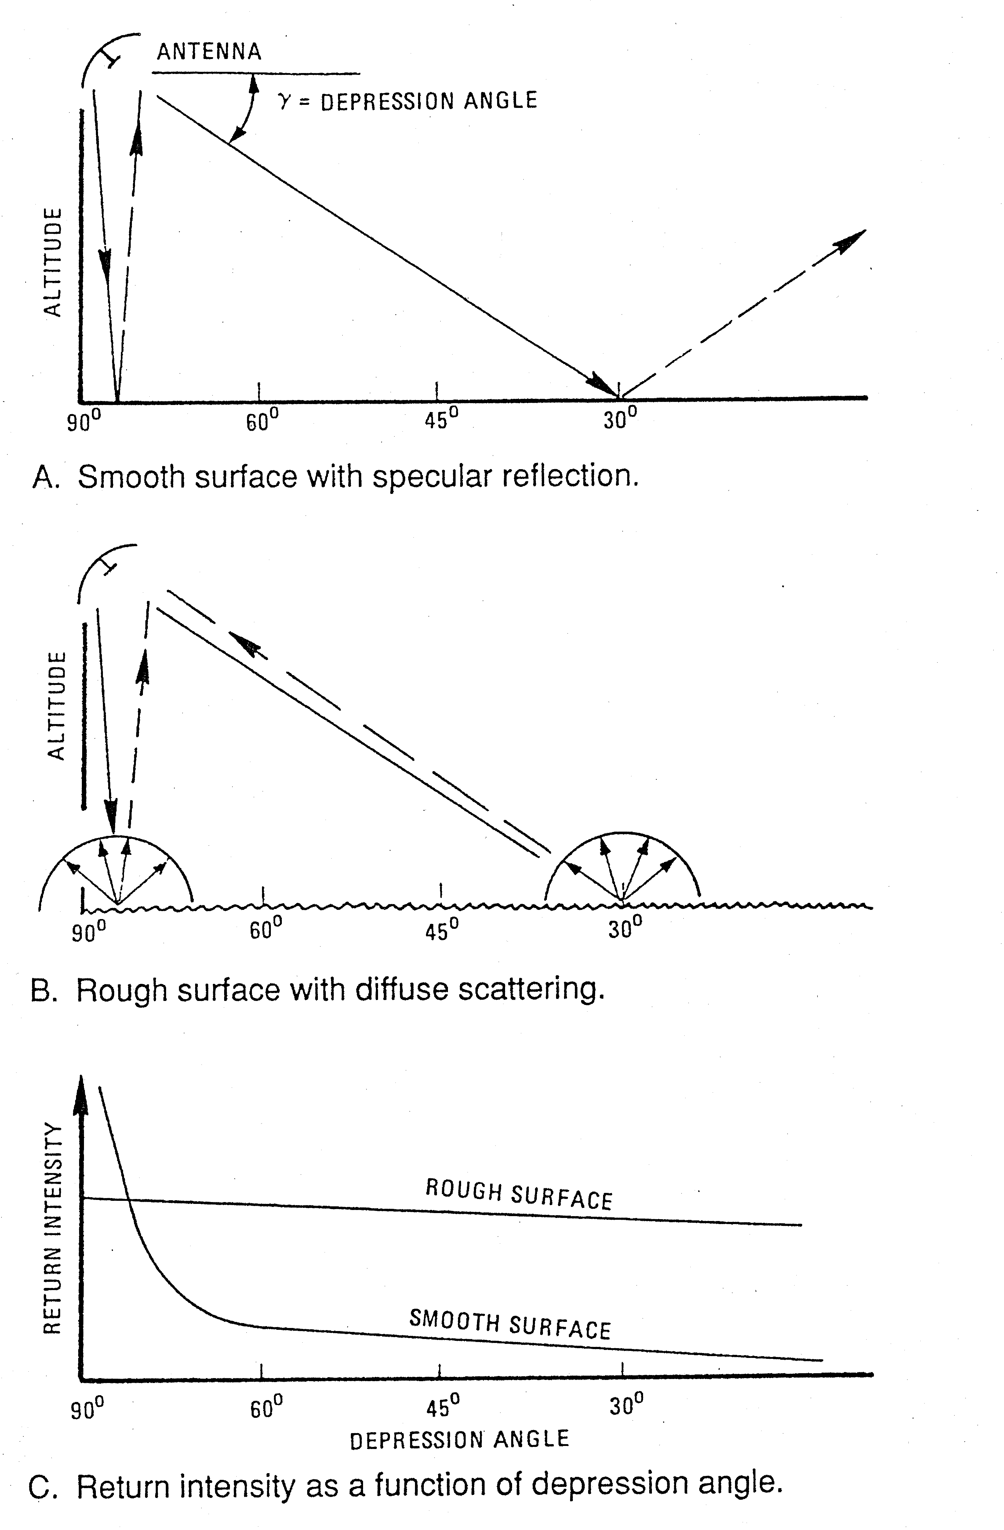

Slide 18
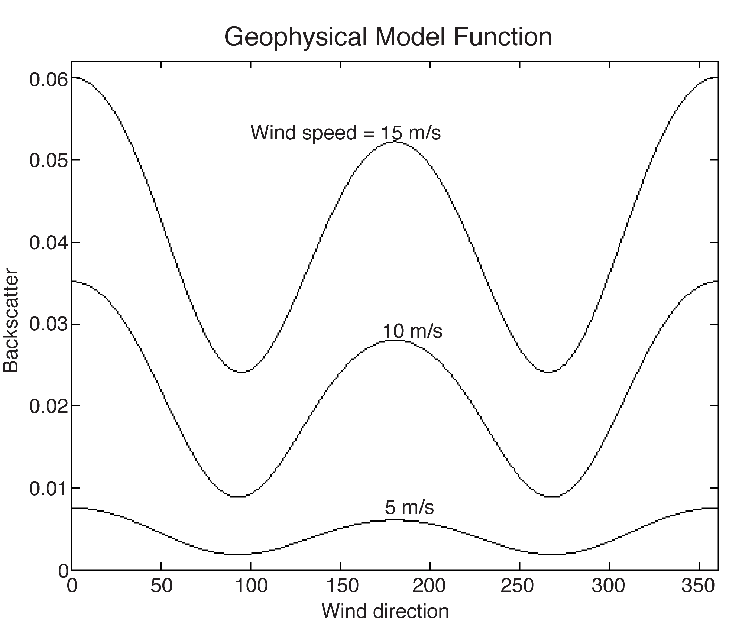

Slide 19
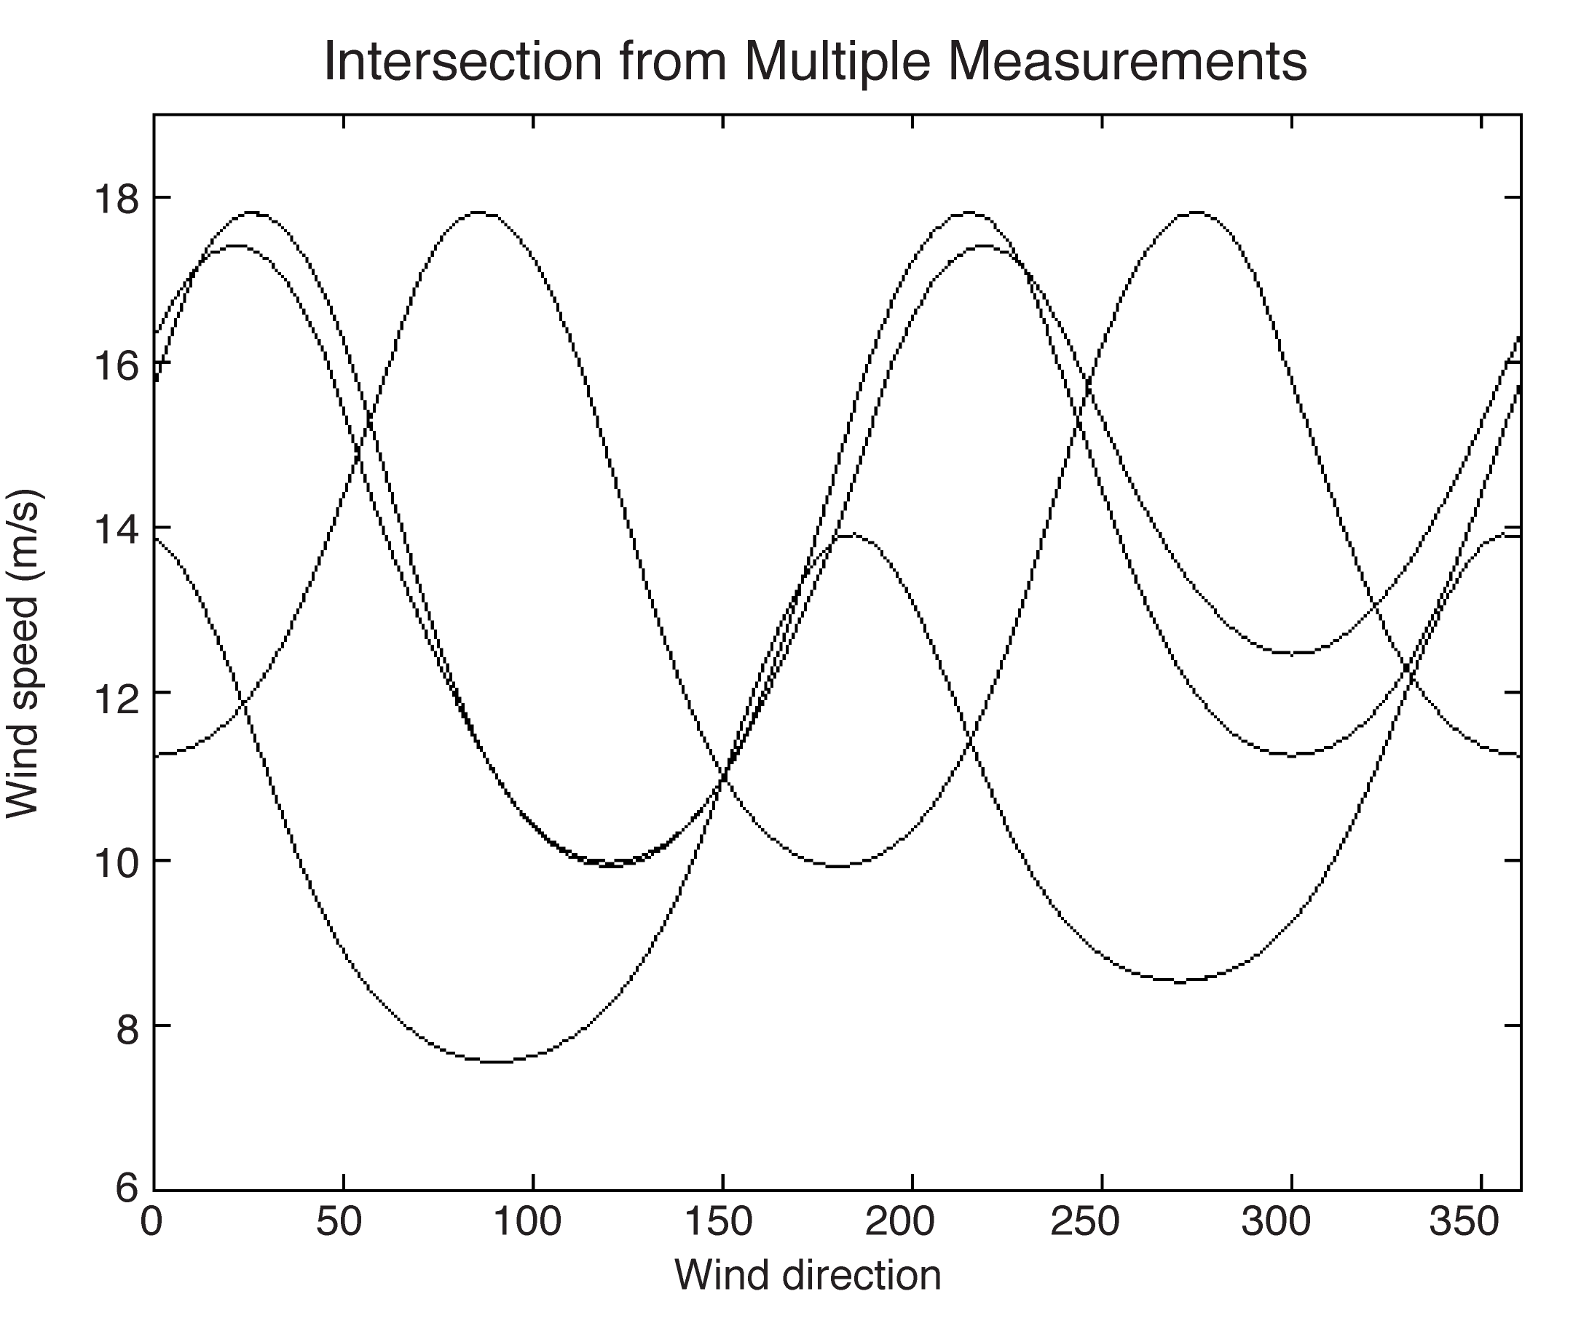
Four different viewing angles

Slide 20
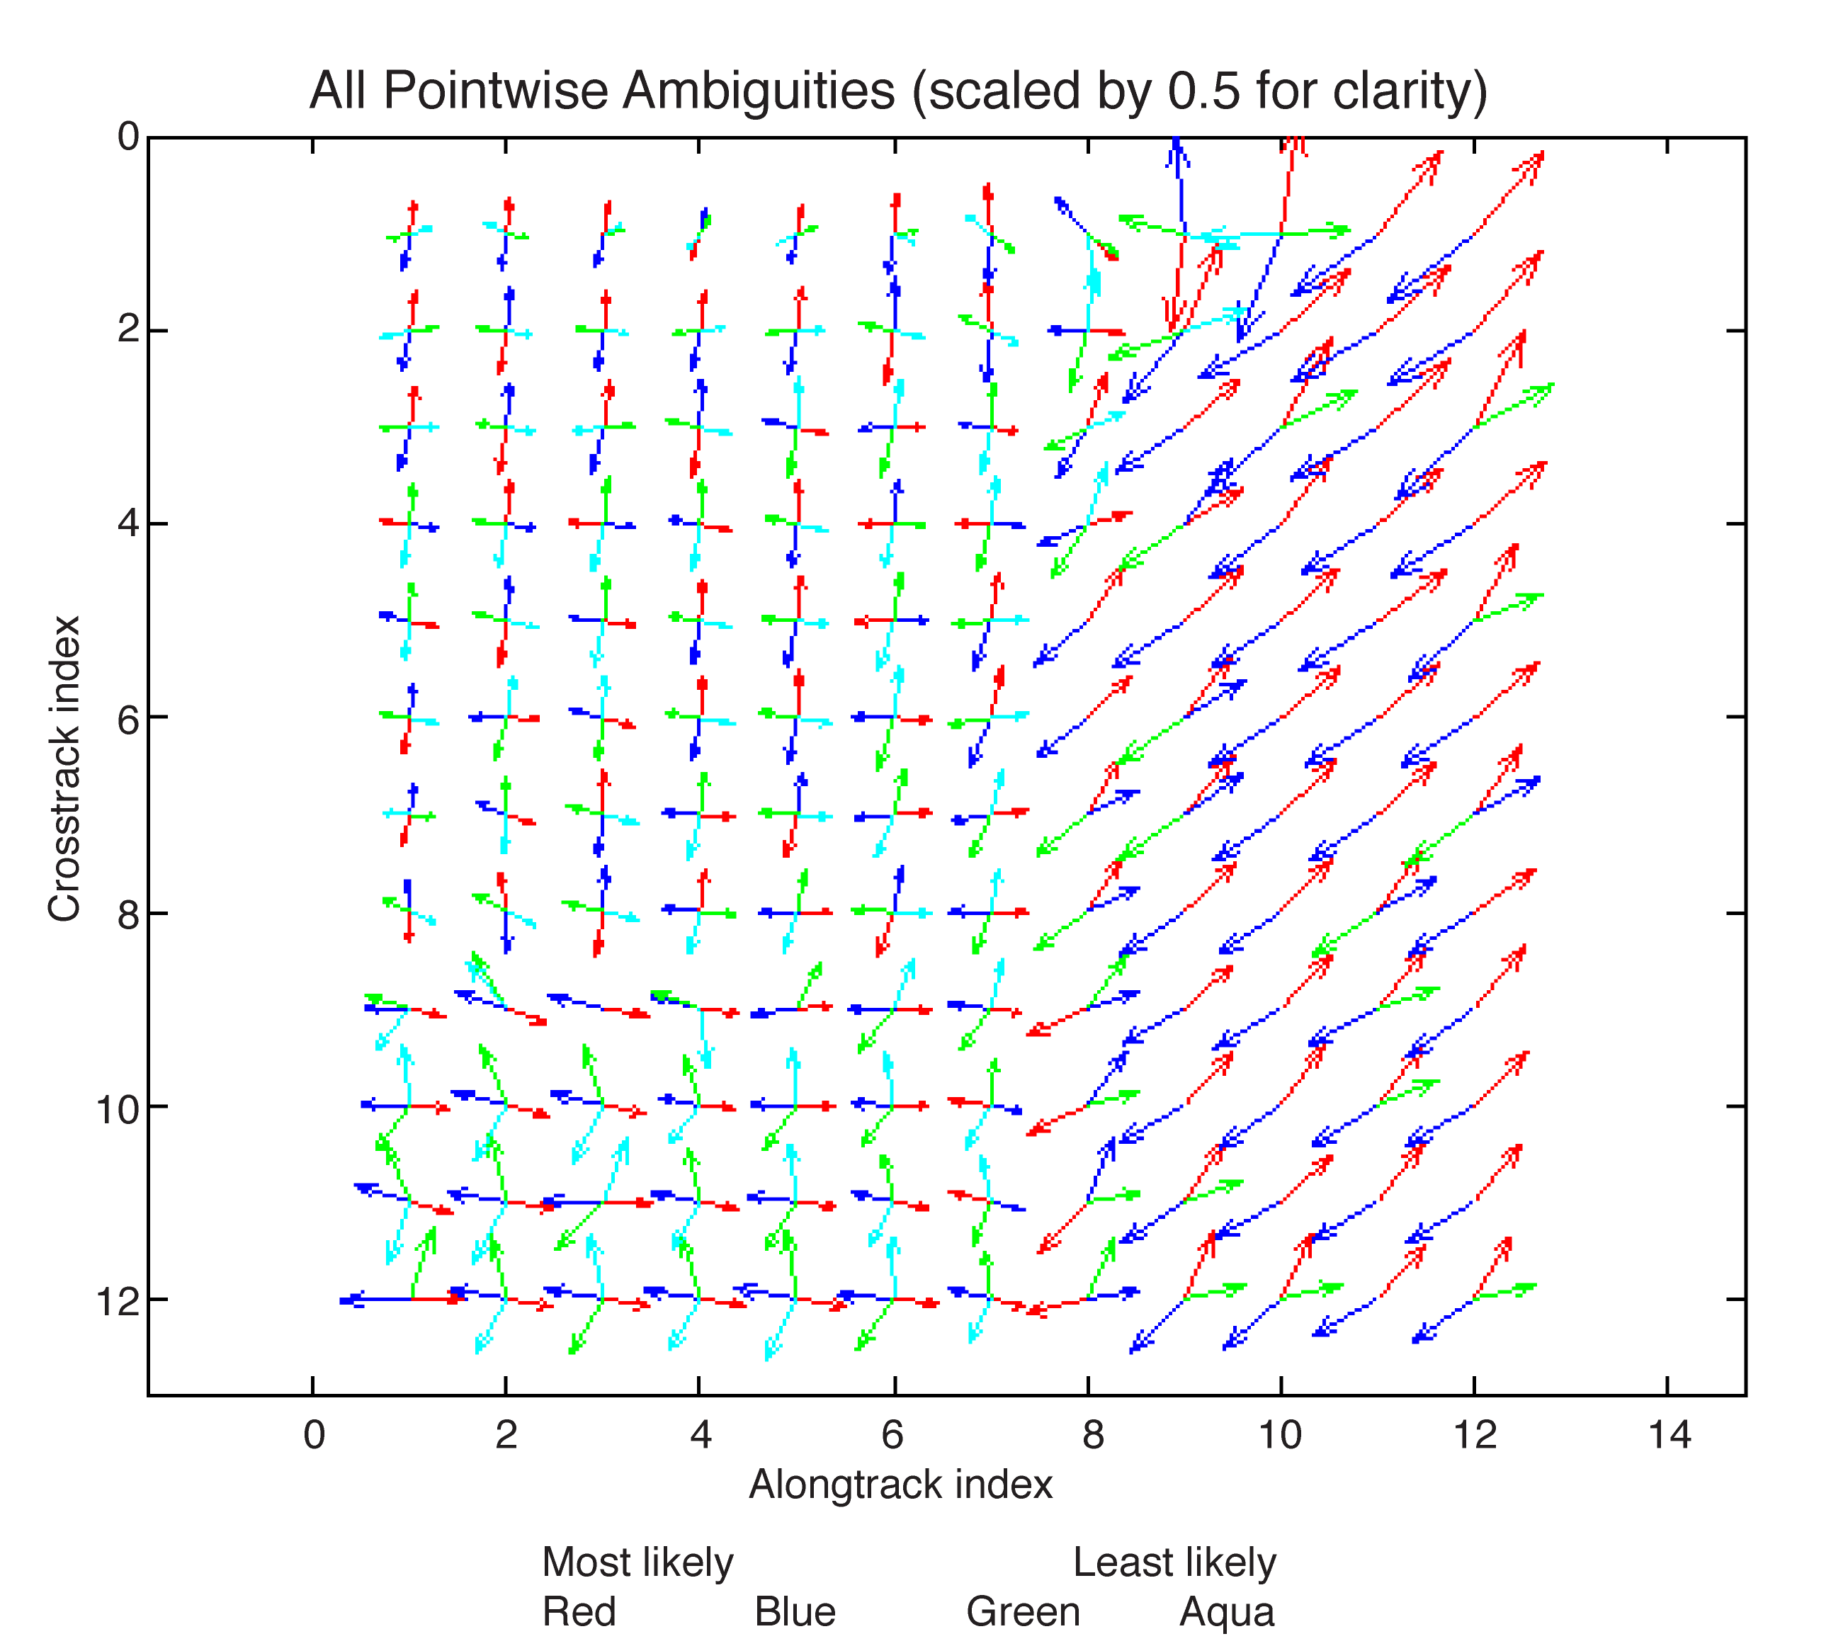

Slide 22
