Slide 1
How do satellites work? Satellites, sensors, orbits, and angles

Slide 2
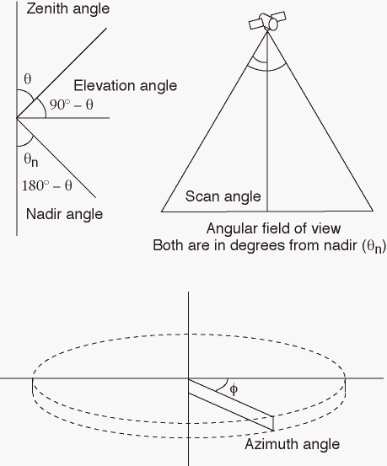

Slide 3
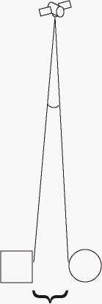
Minimum resolvable distance
Angular resolving power: the angle subtended by imaginary lines passing between an imaging system and two targets placed at the minimum resolvable distance

Slide 4
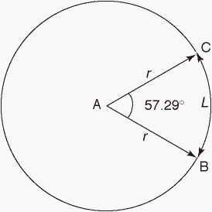
Radian system of angular measurement
The optical system is assumed to be sitting at position A
1 rad = an angle subtended by an arc with a length equal to the radius of the circle (L = r)
The circumference of a circle = 2π (~6.283) rad
1 rad = 360°/2π = angle BAC = 57.29°
1 mrad = 10⁻³ rad

Slide 5
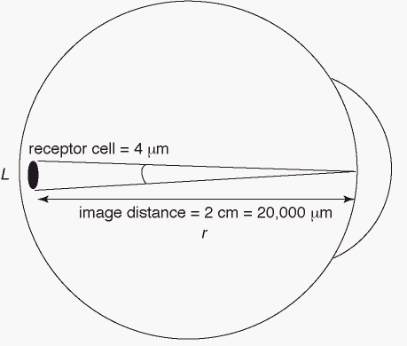
Resolving power of the human eye
Instantaneous field of view (IFOV)
IFOV = L/r rad
= 4/20,000 rad
= 0.0002 rad
= 0.2 mrad
Analogous to a satellite sensor

Slide 6
Apply specifications of the eye to some visual field – as we would with a satellite sensor
Object distance r' is proportional to image distance r
The object size L' is equal to (L/r)r'
where L/r is the IFOV
This defines the spatial resolution
If the black object was smaller
Some of the light from the gray objects would fall on the same receptor
You would have trouble distinguishing between them
How big must L' be for the average person to resolve it at a distance of 30 m?

Slide 7
Apply specifications of the eye to some visual field – as we would with a satellite sensor
Object distance r' is proportional to image distance r
The object size L' is equal to (L/r)r'
where L/r is the IFOV
This defines the spatial resolution
If the black object was smaller
Some of the light from the gray objects would fall on the same receptor
You would have trouble distinguishing between them
How big must L' be for the average person to resolve it at a distance of 30 m?

Slide 8
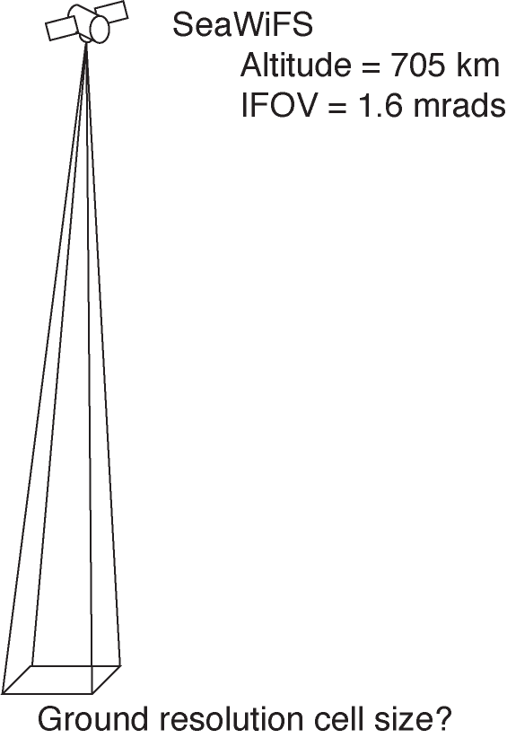

Slide 9
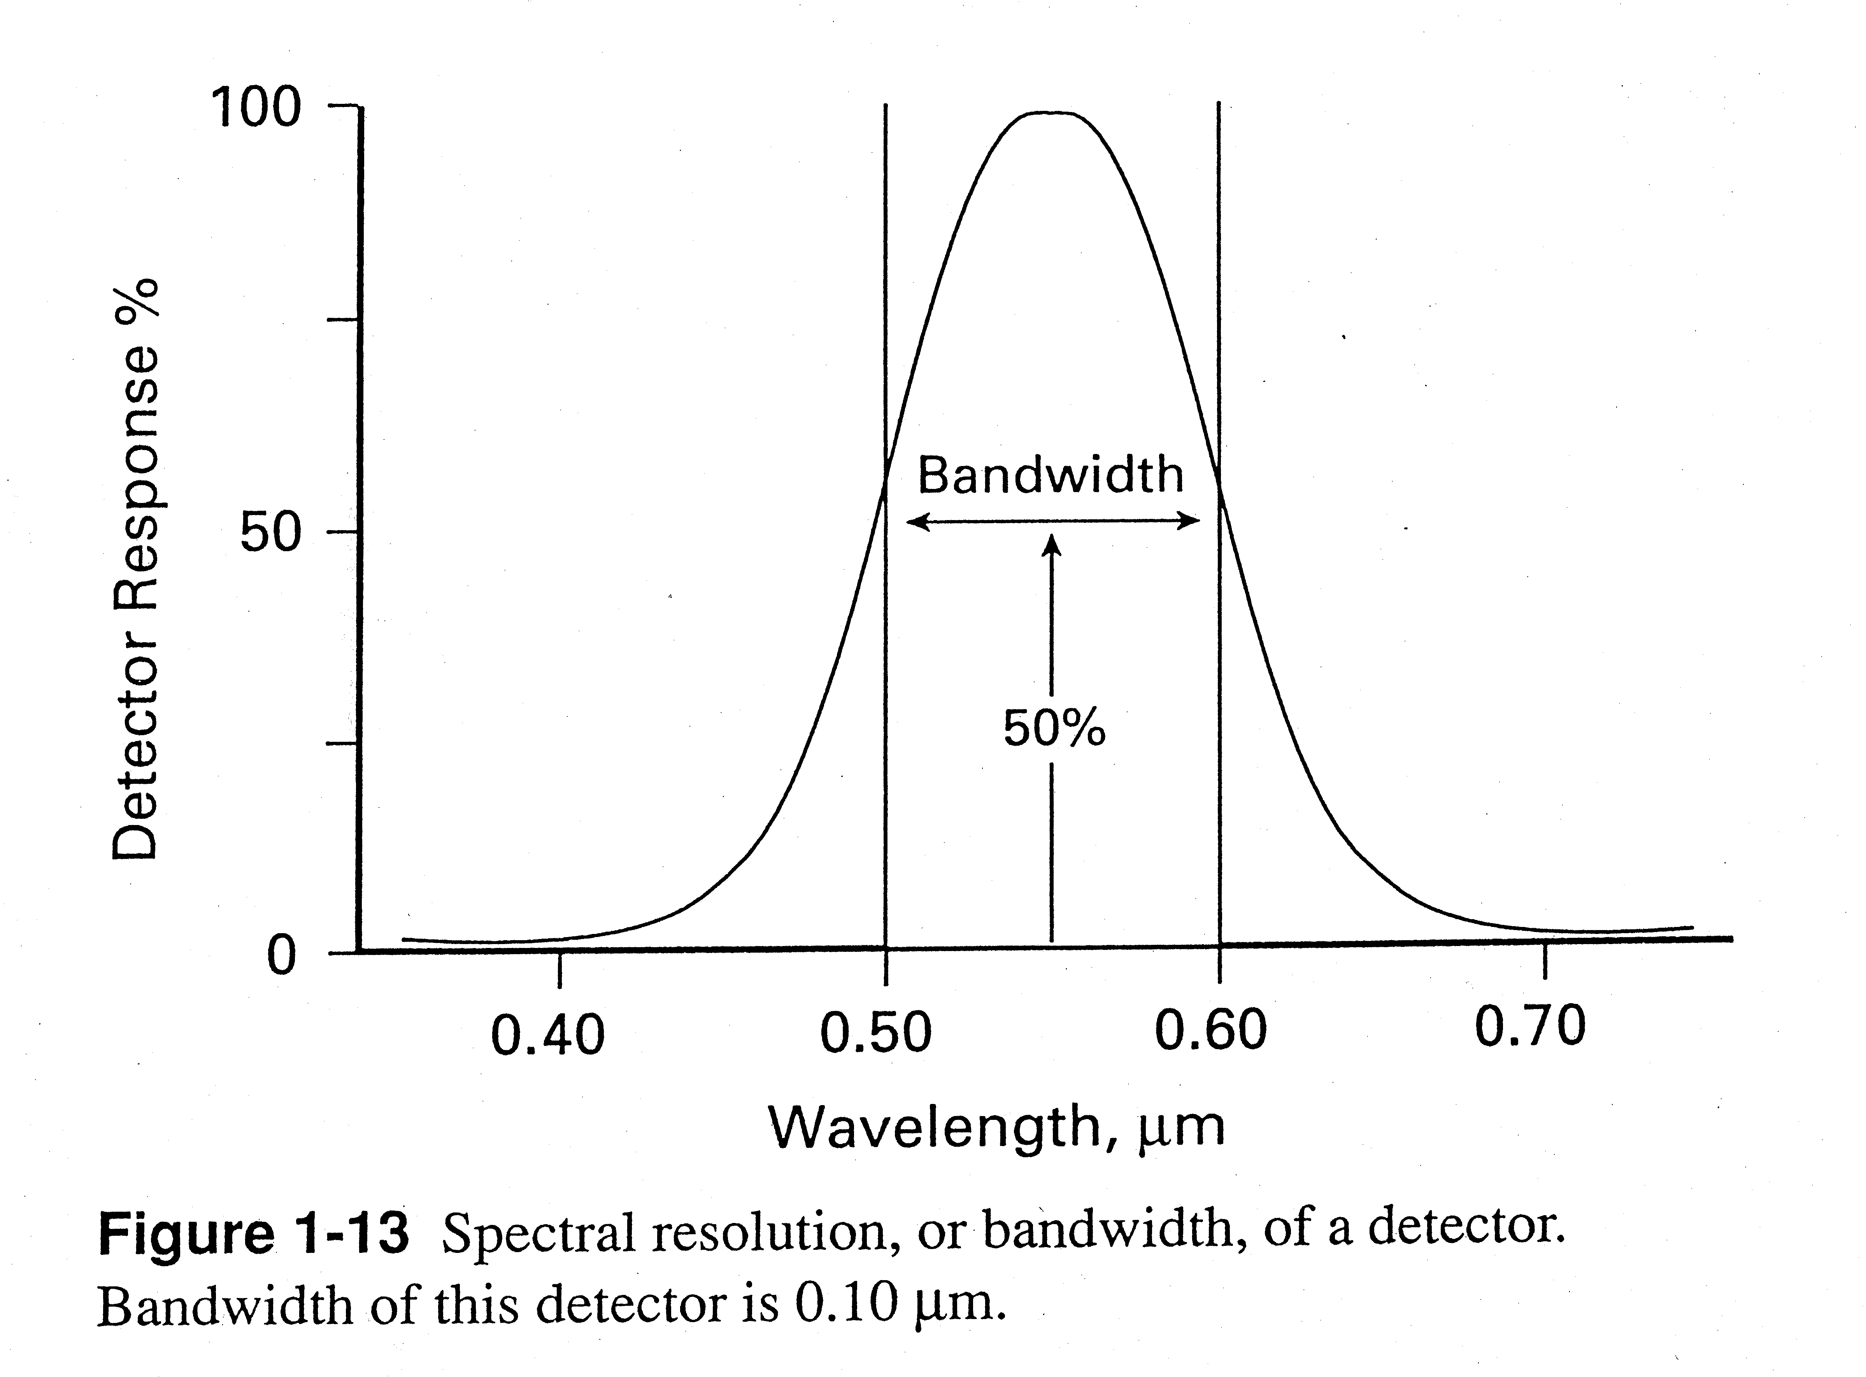
Spectral resolution

Slide 10
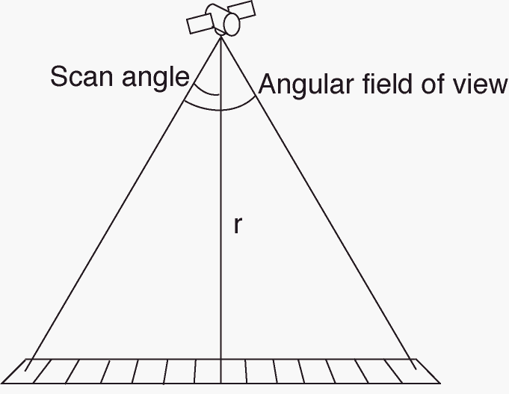
Ground swath width = 2 tan(scan angle)r
What is the ground swath width for SeaWiFS (scan angle = 58.3°)?

Slide 11
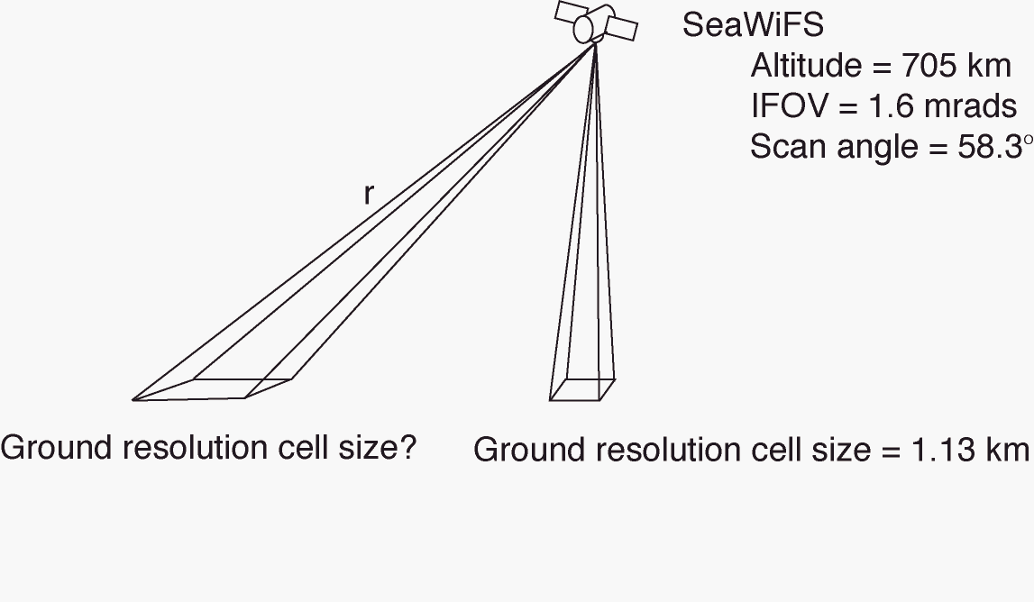
Ground resolution cell (pixel) size = (r)IFOV
r = altitude/cos(scan angle)

Slide 12
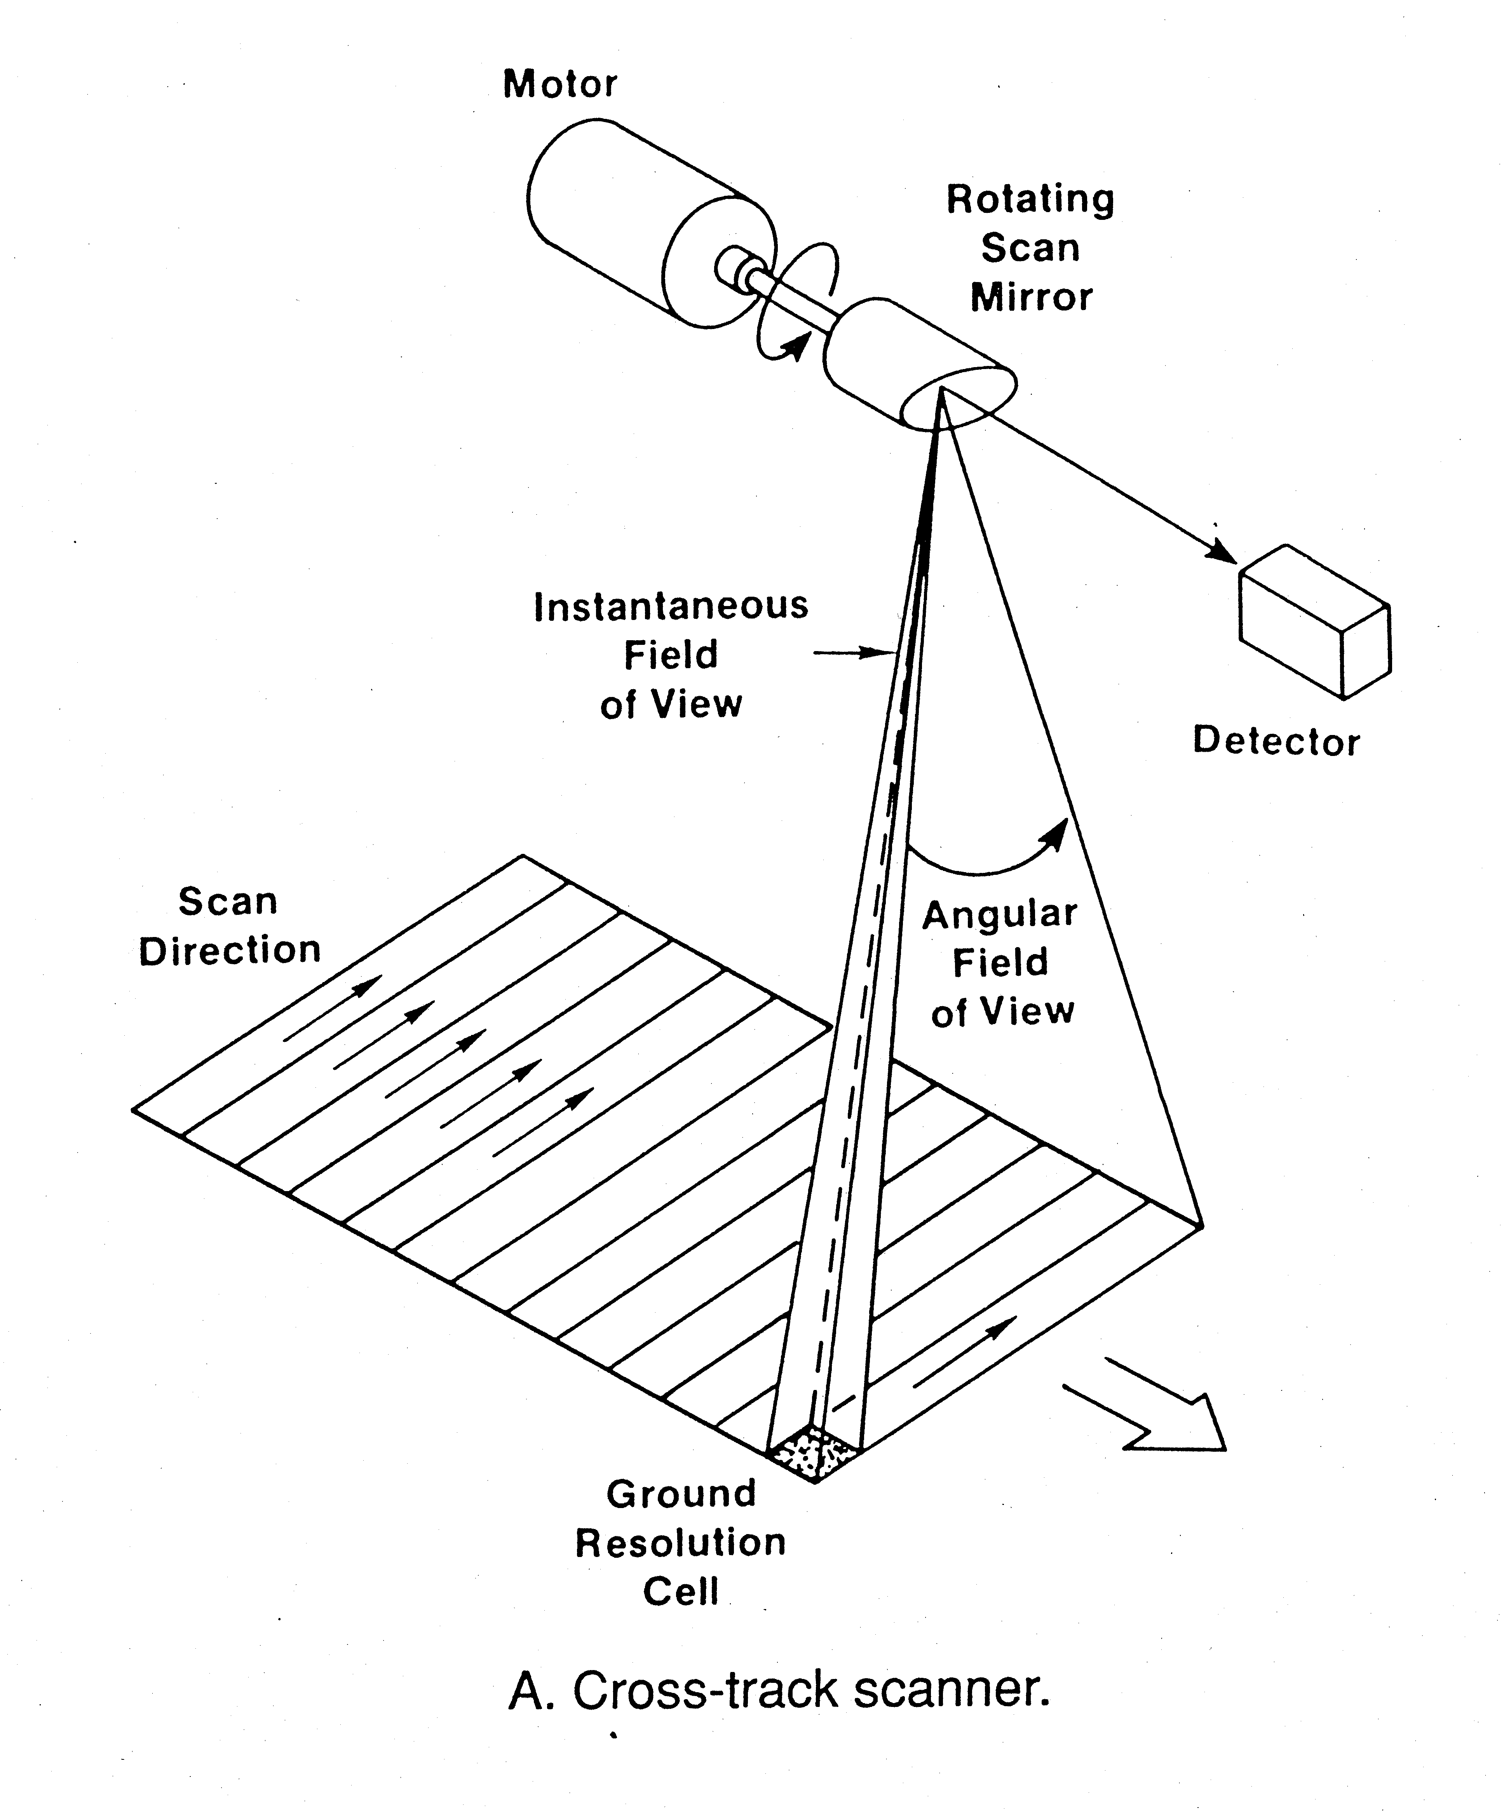

Slide 13
What is the dwell time for a cross track scanner?

Slide 14
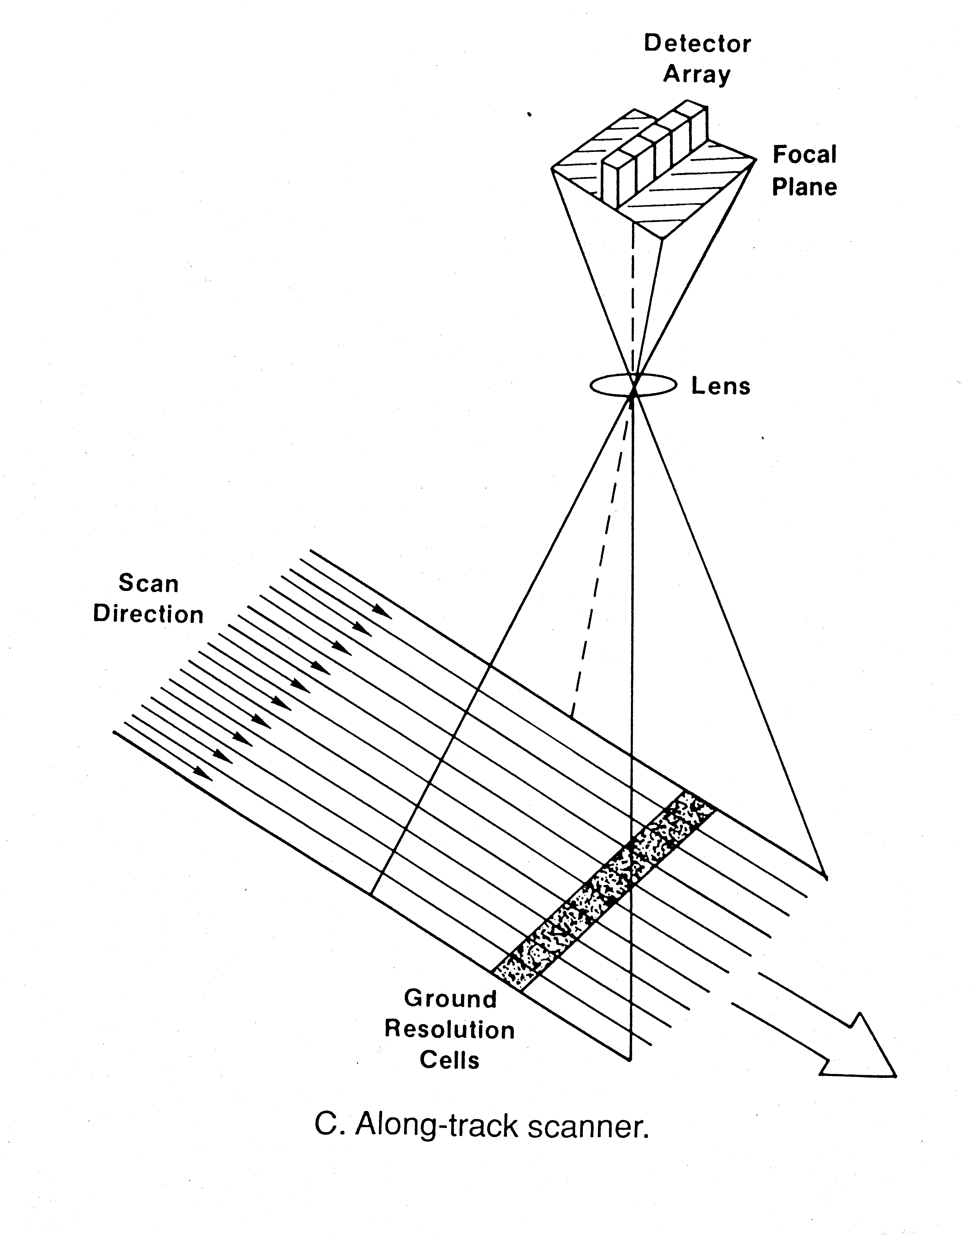

Slide 15
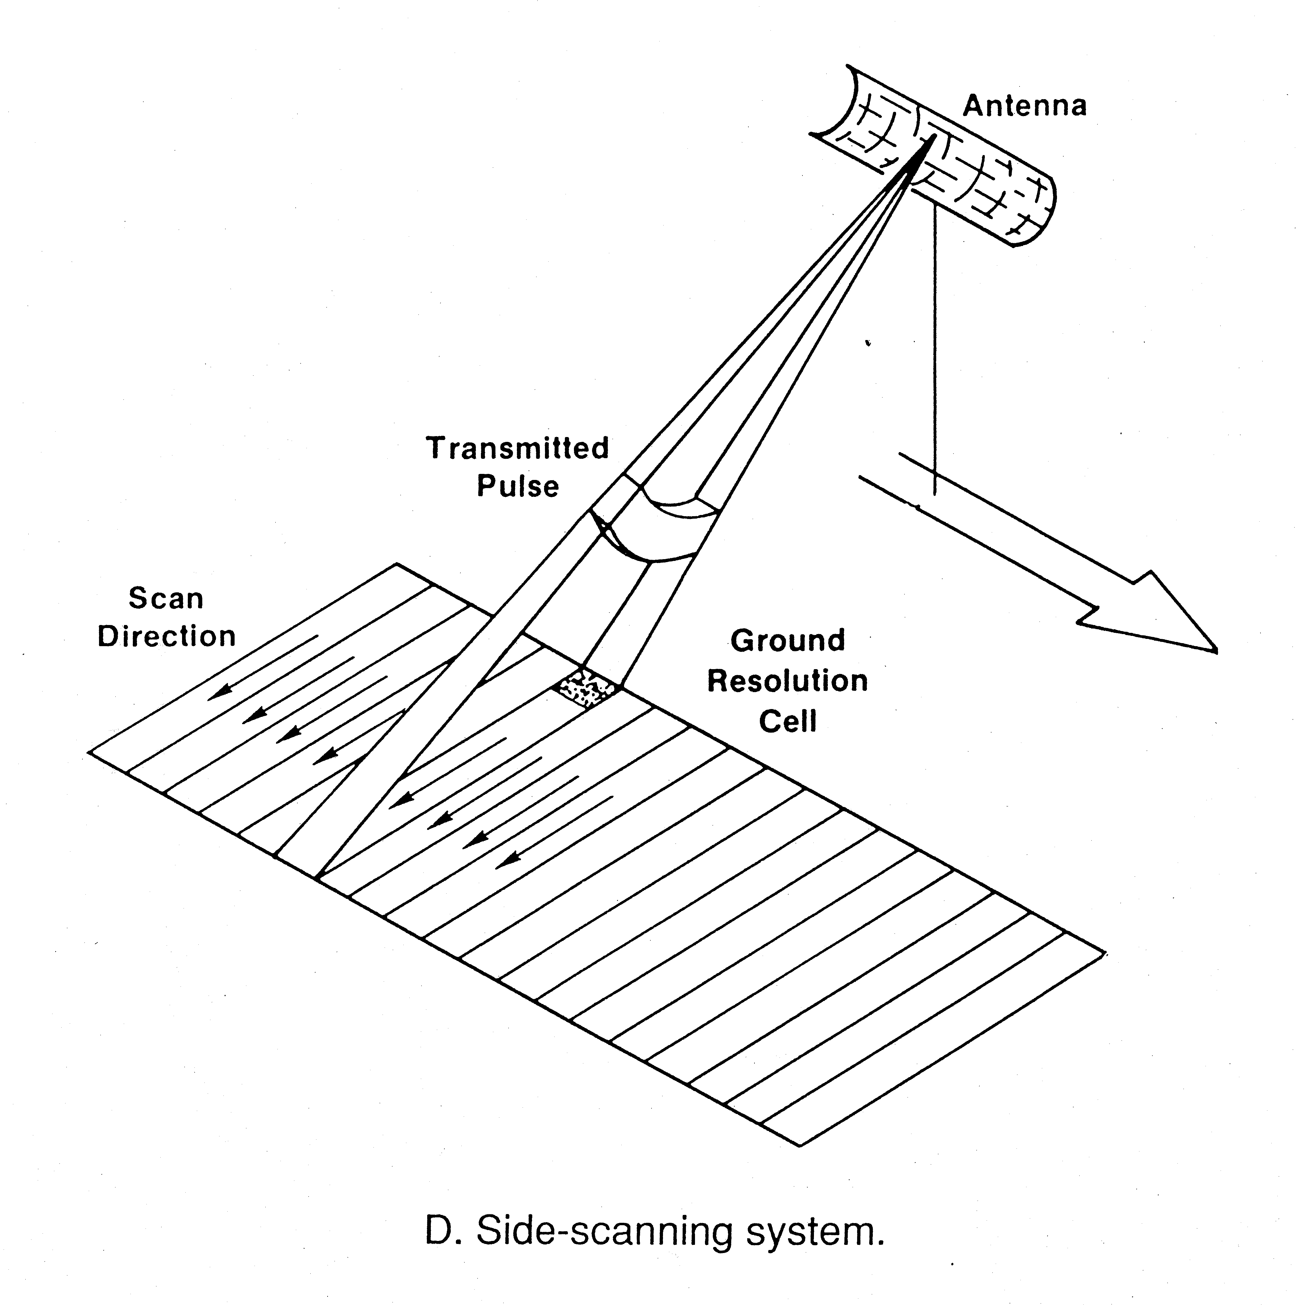

Slide 16
What determines signal strength?

Slide 17
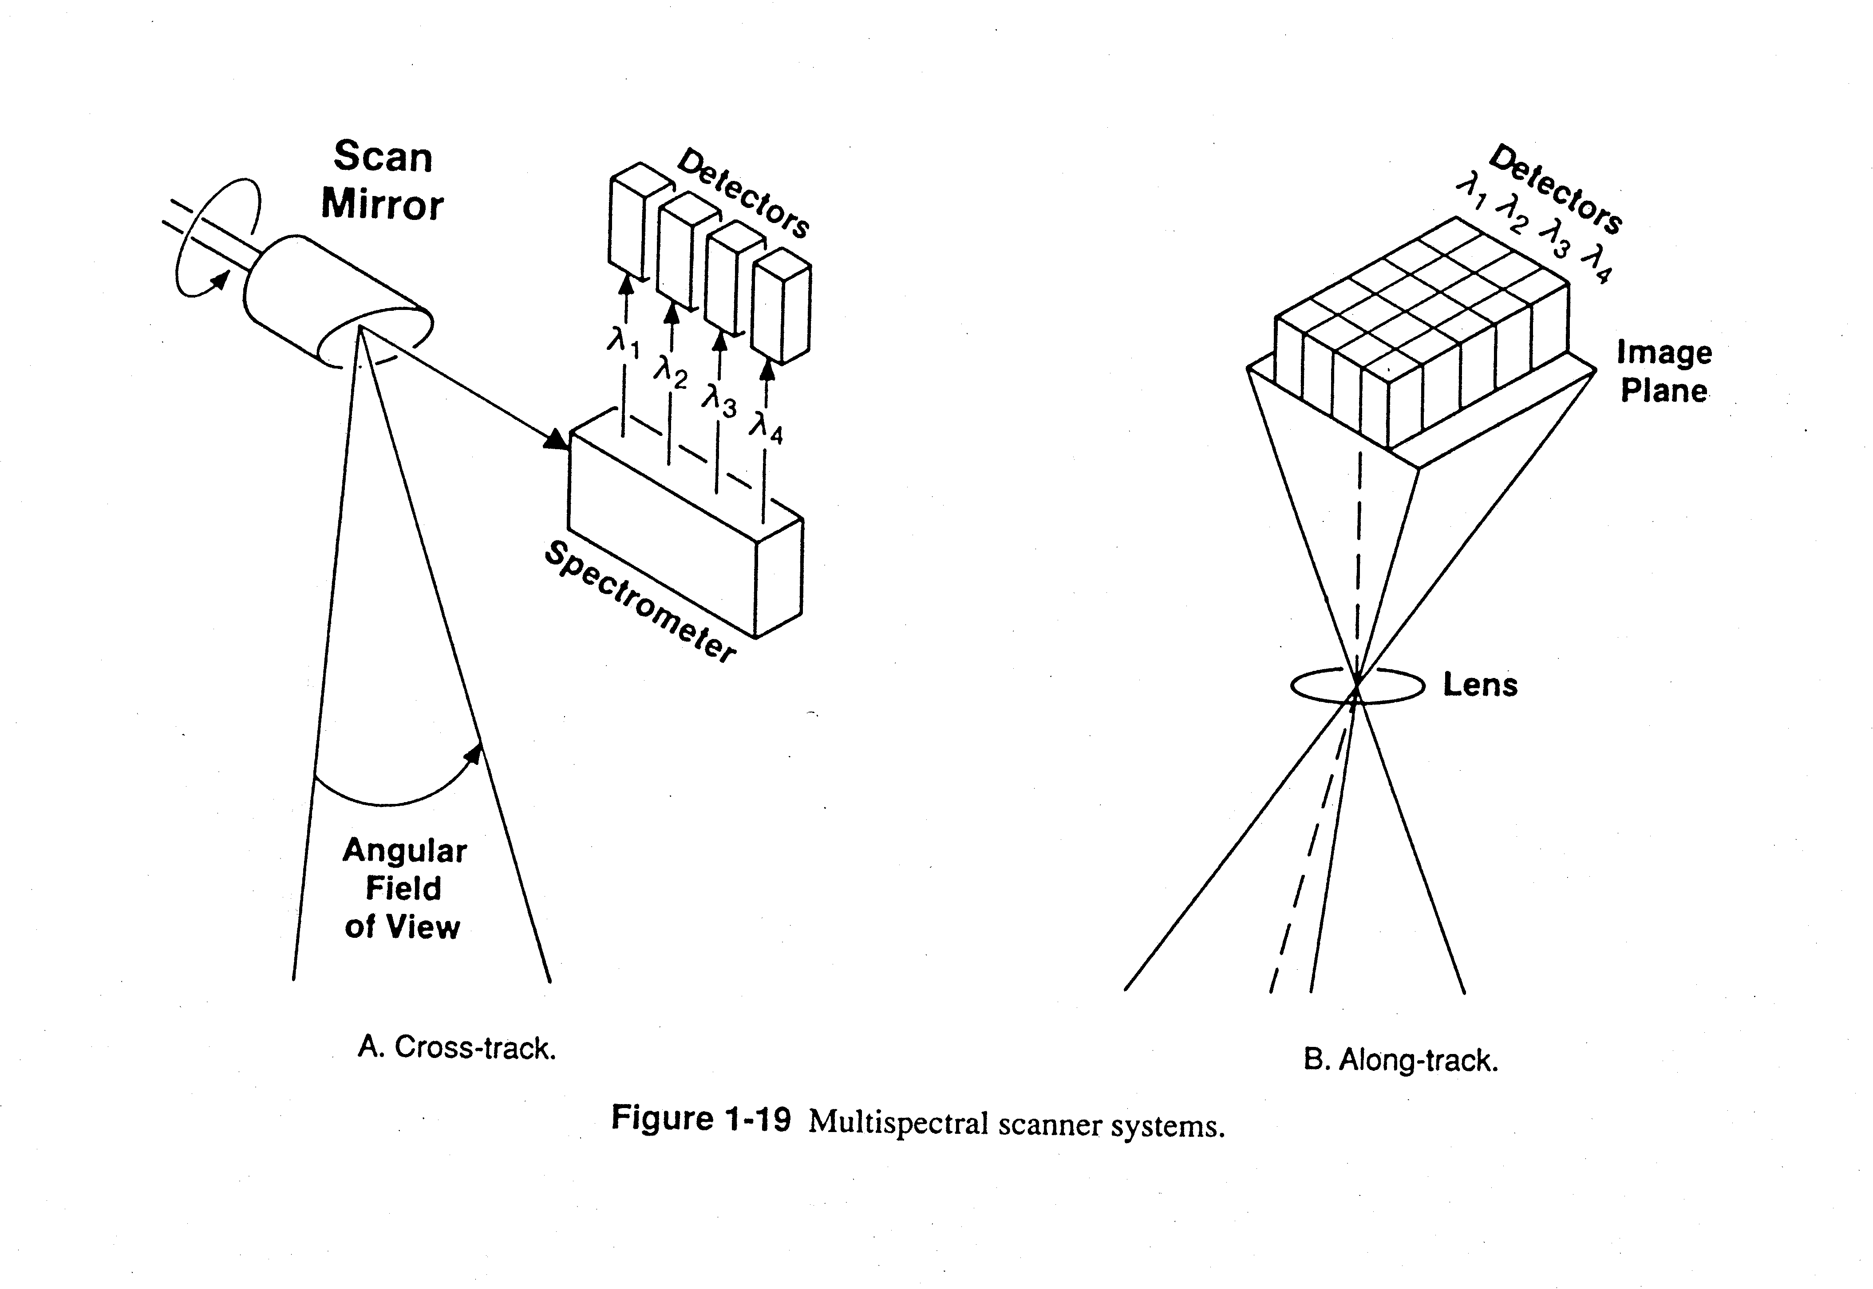

Slide 18
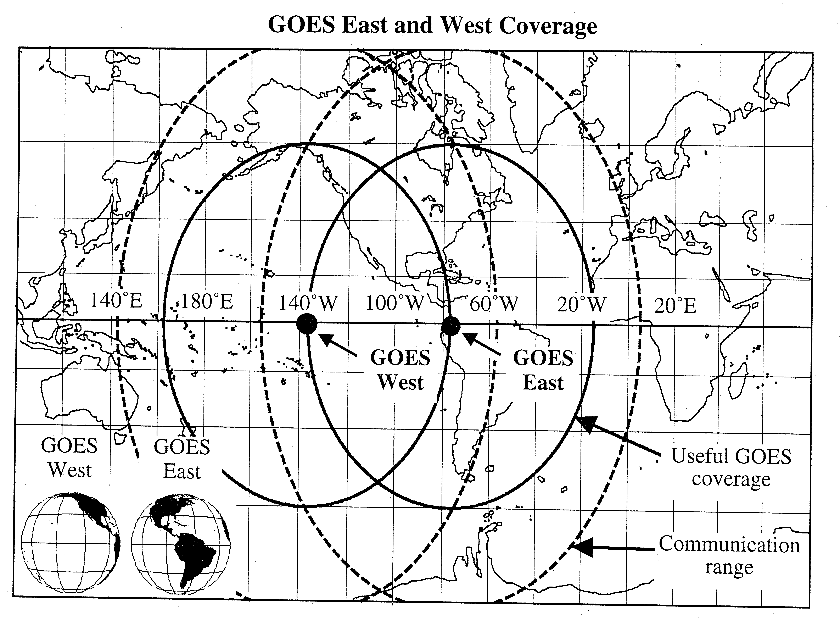
Geosynchronous (geostationary) orbit

Slide 19
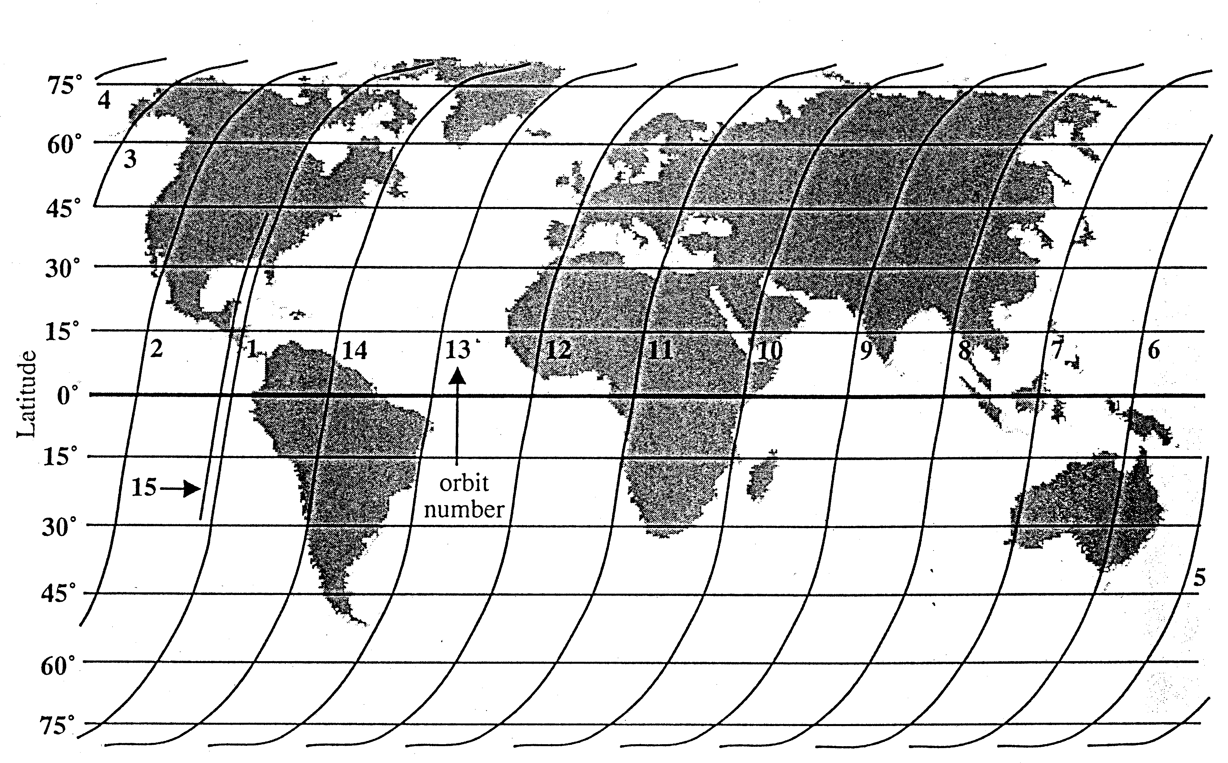
Polar orbit

Slide 20
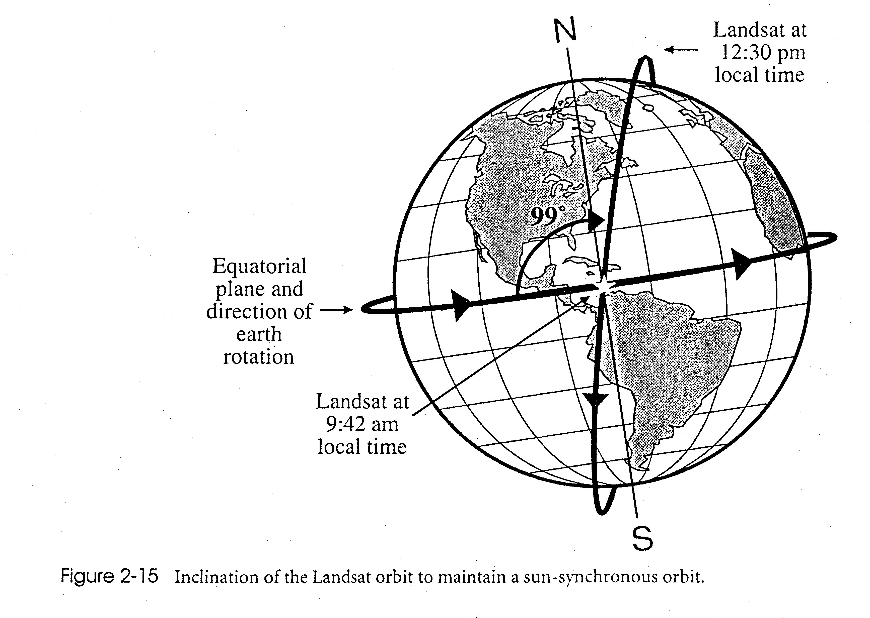

Slide 21
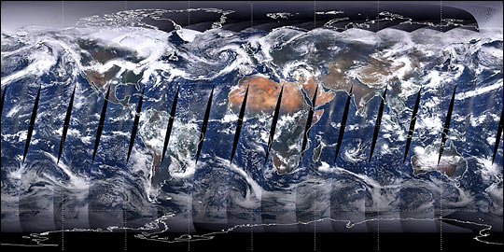

Slide 22
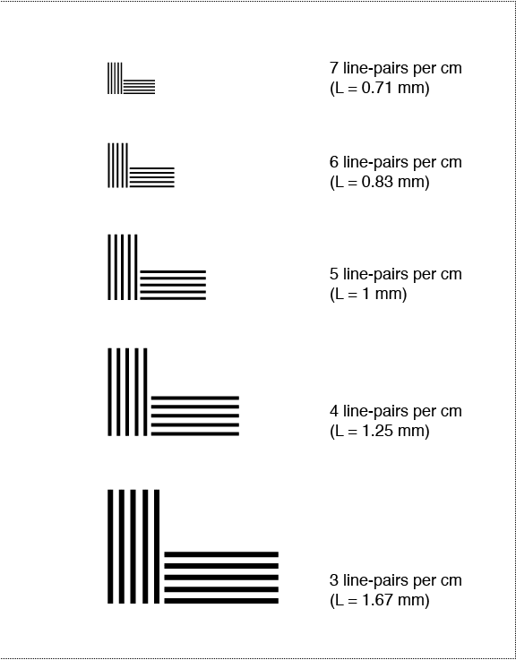

Slide 23
