Slide 1
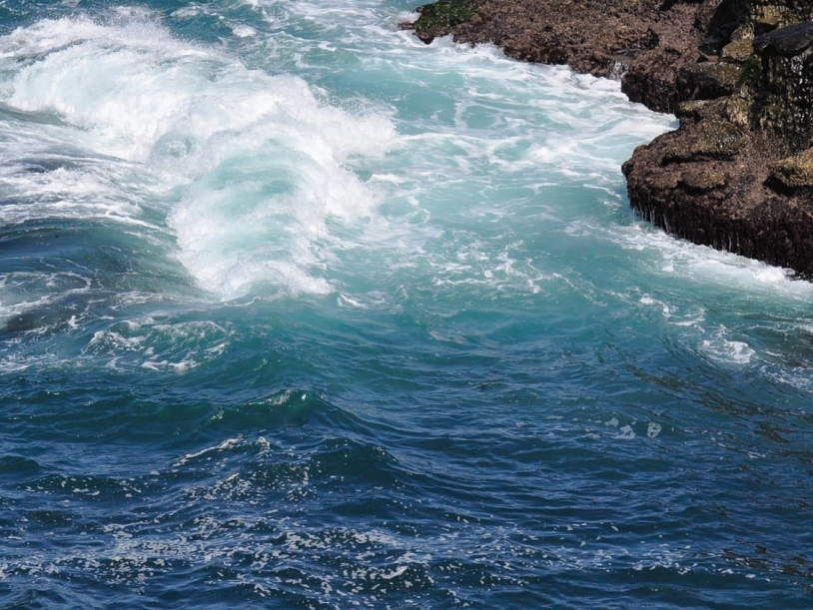
The Physical Properties of Water
EARTHSYS 8: The Oceans
Reading: Investigating Oceanography, Chapter 4

Slide 2
Physical Properties of Water
Outline
Water Structure & Heat
Density
Heat Transmission
Light in the Ocean
Sound Transmission

Slide 3
The Water Molecule

Slide 4
The Water Molecule
Covalent bonds between H⁺ and O²⁻

Slide 5
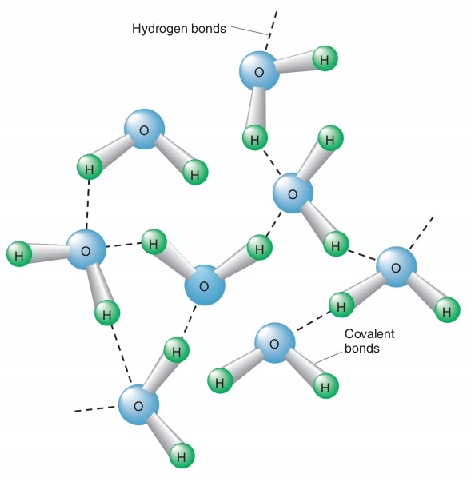
The Water Molecule
Covalent bonds between H⁺ and O²⁻
Polarity allows hydrogen bonds
Hydrogen bonds constantly form and break, giving water its structure

Slide 6
Temperature & Heat

Slide 7
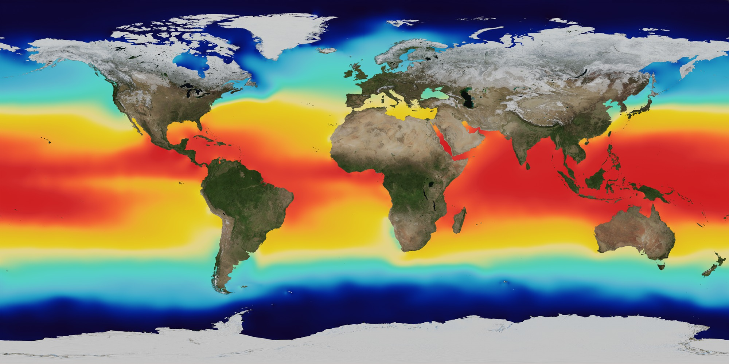
Temperature & Heat
Temperature: Average Kinetic Energy
Heat: Total Kinetic Energy (1 calorie ~ 4.2 Joules)

Slide 8
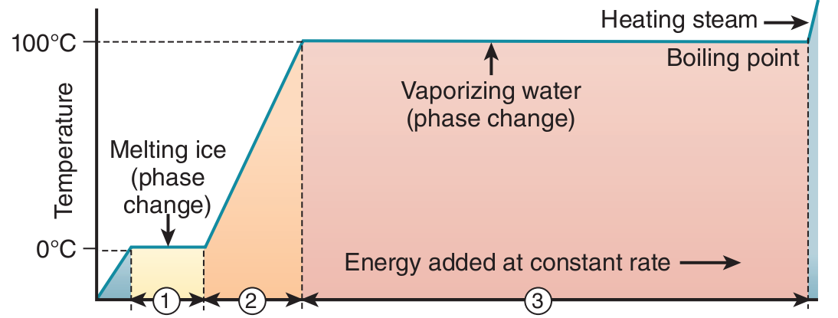
Changes of State
Heat affects temperature or state
Notes:
Why doesn’t the temperature change during state transitions?

Slide 9
Ice Formation: Molecular View
Molecules slow as heat is lost → hydrogen bonds form with rigid structure
Liquid Water
Ice
Matsumoto et al., 2002, Nature
Notes:
What would this transition look like for the phase change from liquid water to gas water vapor?

Slide 10
Ice Formation: Molecular View
Molecules slow as heat is lost → hydrogen bonds form with rigid structure
Why does salt decrease the freezing point of water?
Liquid Water
Ice
Matsumoto et al., 2002, Nature
Notes:
What would this transition look like for the phase change from liquid water to gas water vapor?

Slide 11
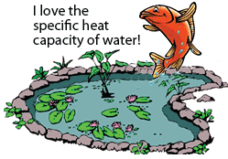
Specific Heat of Water
The heat needed to raise 1 gram of water 1°C
Very high compared to air and land materials
Units: cal/gram/°C

Slide 12
Surface Tension
Product of cohesion & hydrogen bonds
Important for early wave formation
Surface tension increased by higher salt content and lower temperature

Slide 13
Surface Tension
Product of cohesion & hydrogen bonds
Important for early wave formation
Surface tension increased by higher salt content and lower temperature
How does the high surface tension of water help generate waves?

Slide 14
Viscosity
Measure of internal friction
Seawater has very low viscosity
Cold water more viscous than warm water

Slide 15
Viscosity
Measure of internal friction
Seawater has very low viscosity
Cold water more viscous than warm water
What kinds of marine organisms are affected by changes in seawater viscosity with temperature?

Slide 16
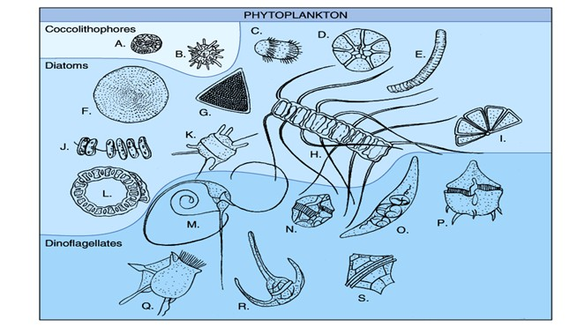
Viscosity
Measure of internal friction
Seawater has very low viscosity
Cold water more viscous than warm water
Organisms stay afloat by adopting appendages, small cell sizes

Slide 18
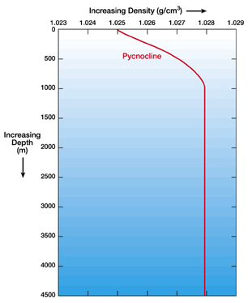
Density
Why is density important for the ocean?
Density controls the structure & circulation of the ocean
Denser water sinks;
Less dense water floats

Slide 19
Density
How does pressure affect density?
High pressure slightly compresses seawater, increasing its density at depth
This leads to a 37 m decrease in sea level!

Slide 20
Density
How does temperature affect density?
Decreasing temperature increases density; cold water is denser
Molecules are slower at colder temperatures and more concentrated

Slide 21
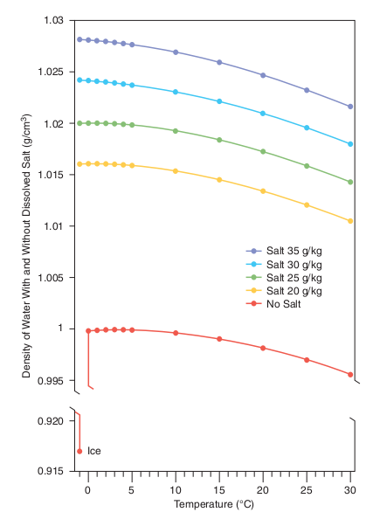
Density
How does salinity affect density?
Density increases with increasing salinity
Fresher water floats, high salinity water sinks; Controls circulation

Slide 22
Heat transmission in the ocean
Upper ocean heated directly by solar radiation
Conduction is molecular heat exchange; inefficient process that allows lateral transport
Convection is density-driven heat exchange;
ex: loss of heat to atmosphere

Slide 23
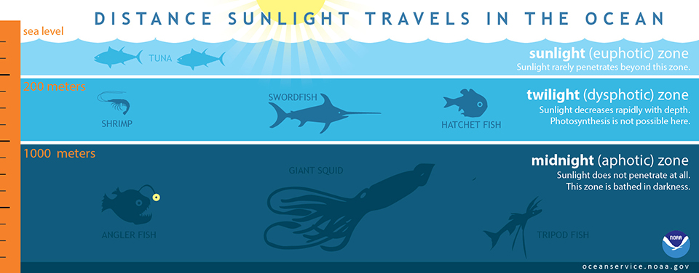
Light transmission in the ocean
Sunlight enters the surface ocean, extinguished with increasing depth (attenuation)

Slide 24
Light transmission in the ocean
Light is absorbed and scattered by water and particles in the ocean
Attenuation = decrease in light intensity over distance
Wavelength- dependent

Slide 25
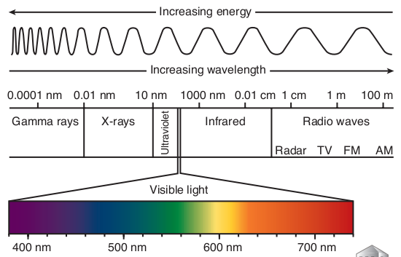
Light transmission
Electromagnetic spectrum

Slide 26
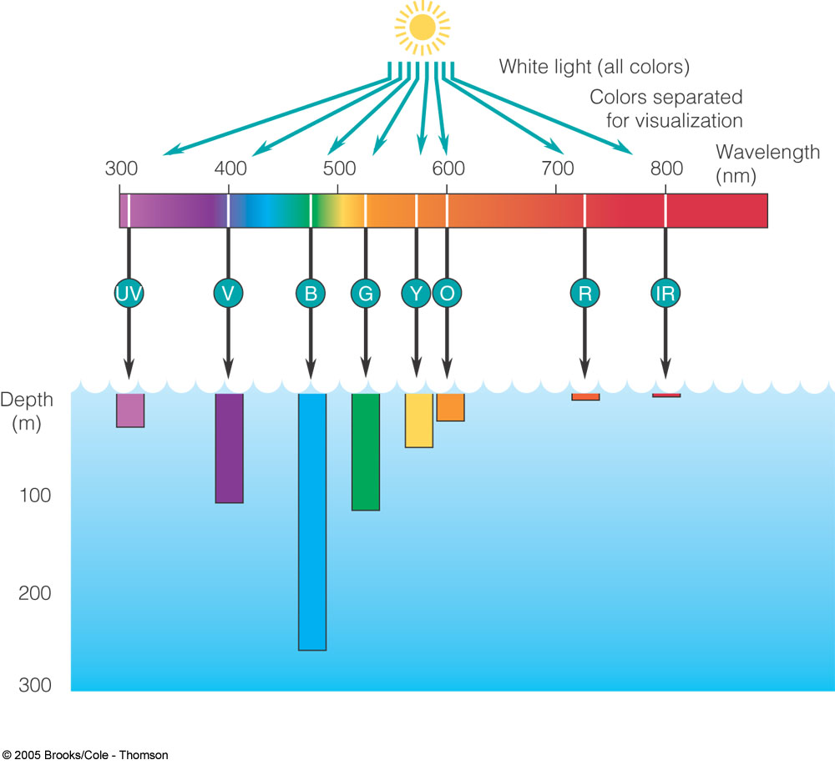
Why is the ocean blue?
Long and short wavelengths are absorbed first (i.e. red and UV)
Blue light is absorbed least and strongly scattered, reflected to our eyes

Slide 27
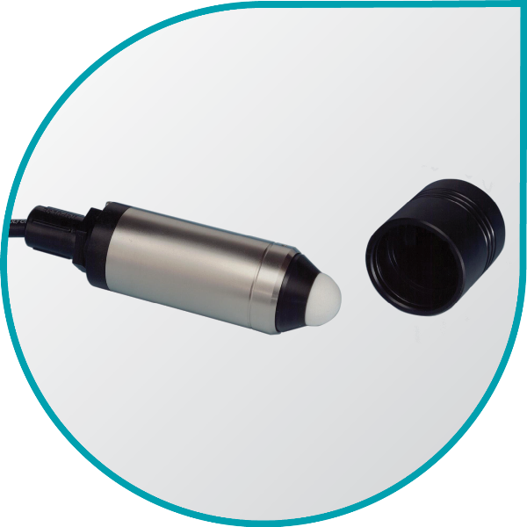
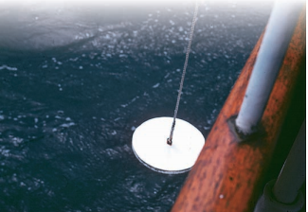
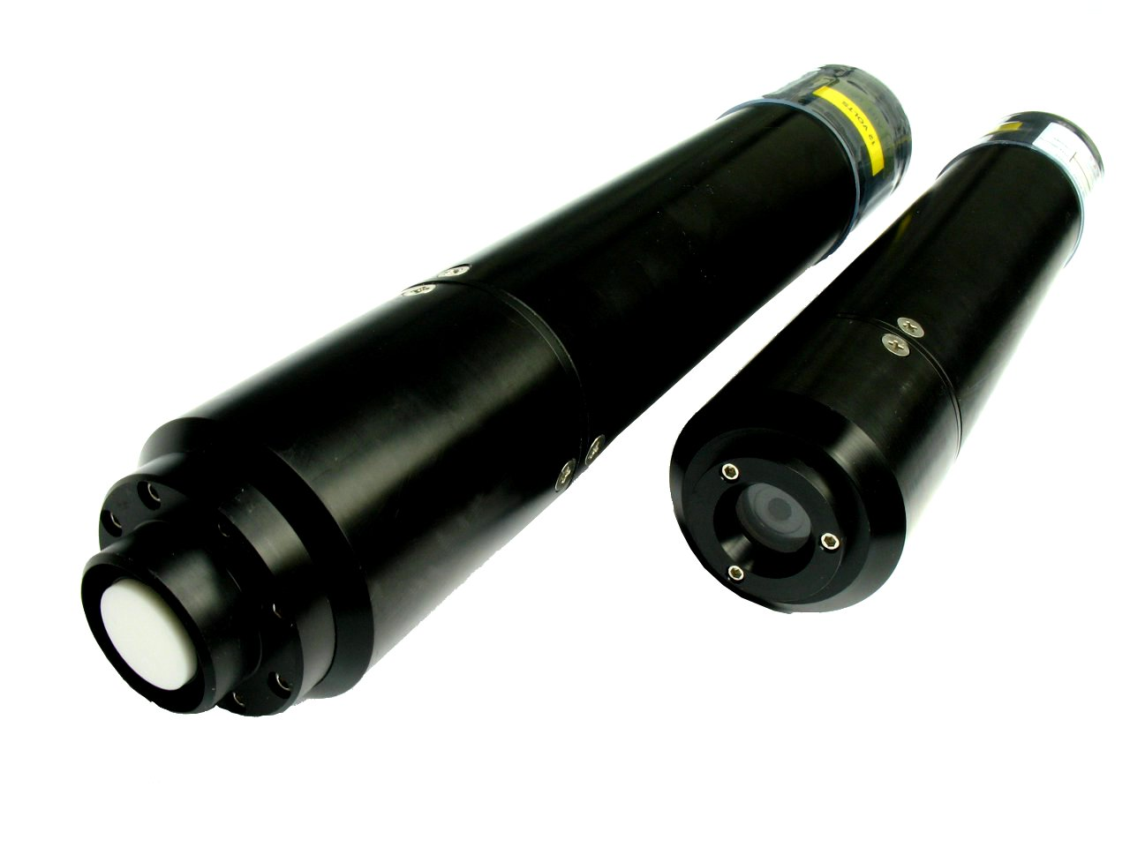
How is ocean light measured?
Irradiance Sensor
Secchi Dish
Radiometer

Slide 28
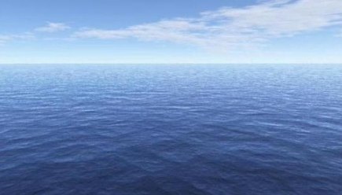
How is light penetration different in open ocean versus coastal waters and why?

Slide 29
Sound transmission in the ocean

Slide 30
Sound transmission in the ocean
Speed of sound is a function of density and compressibility
Speed increases with temperature, salinity & depth
Sofar channel: minimum sound velocity around ~1000 m where sound is trapped

Slide 31
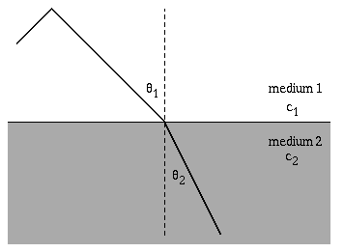
Sound transmission in the ocean
Refraction occurs as speed of sound changes with layers of different properties
Detection of sound speed & angle used for mapping (echosounding) and location (sonar)

